Slide 1
SuperMASSA training section
Marcelo Mollinari
mmollin@ncsu.edu
SCRI Workshop – January 13, 2021
This work is licensed under CC BY 4.0

Slide 2
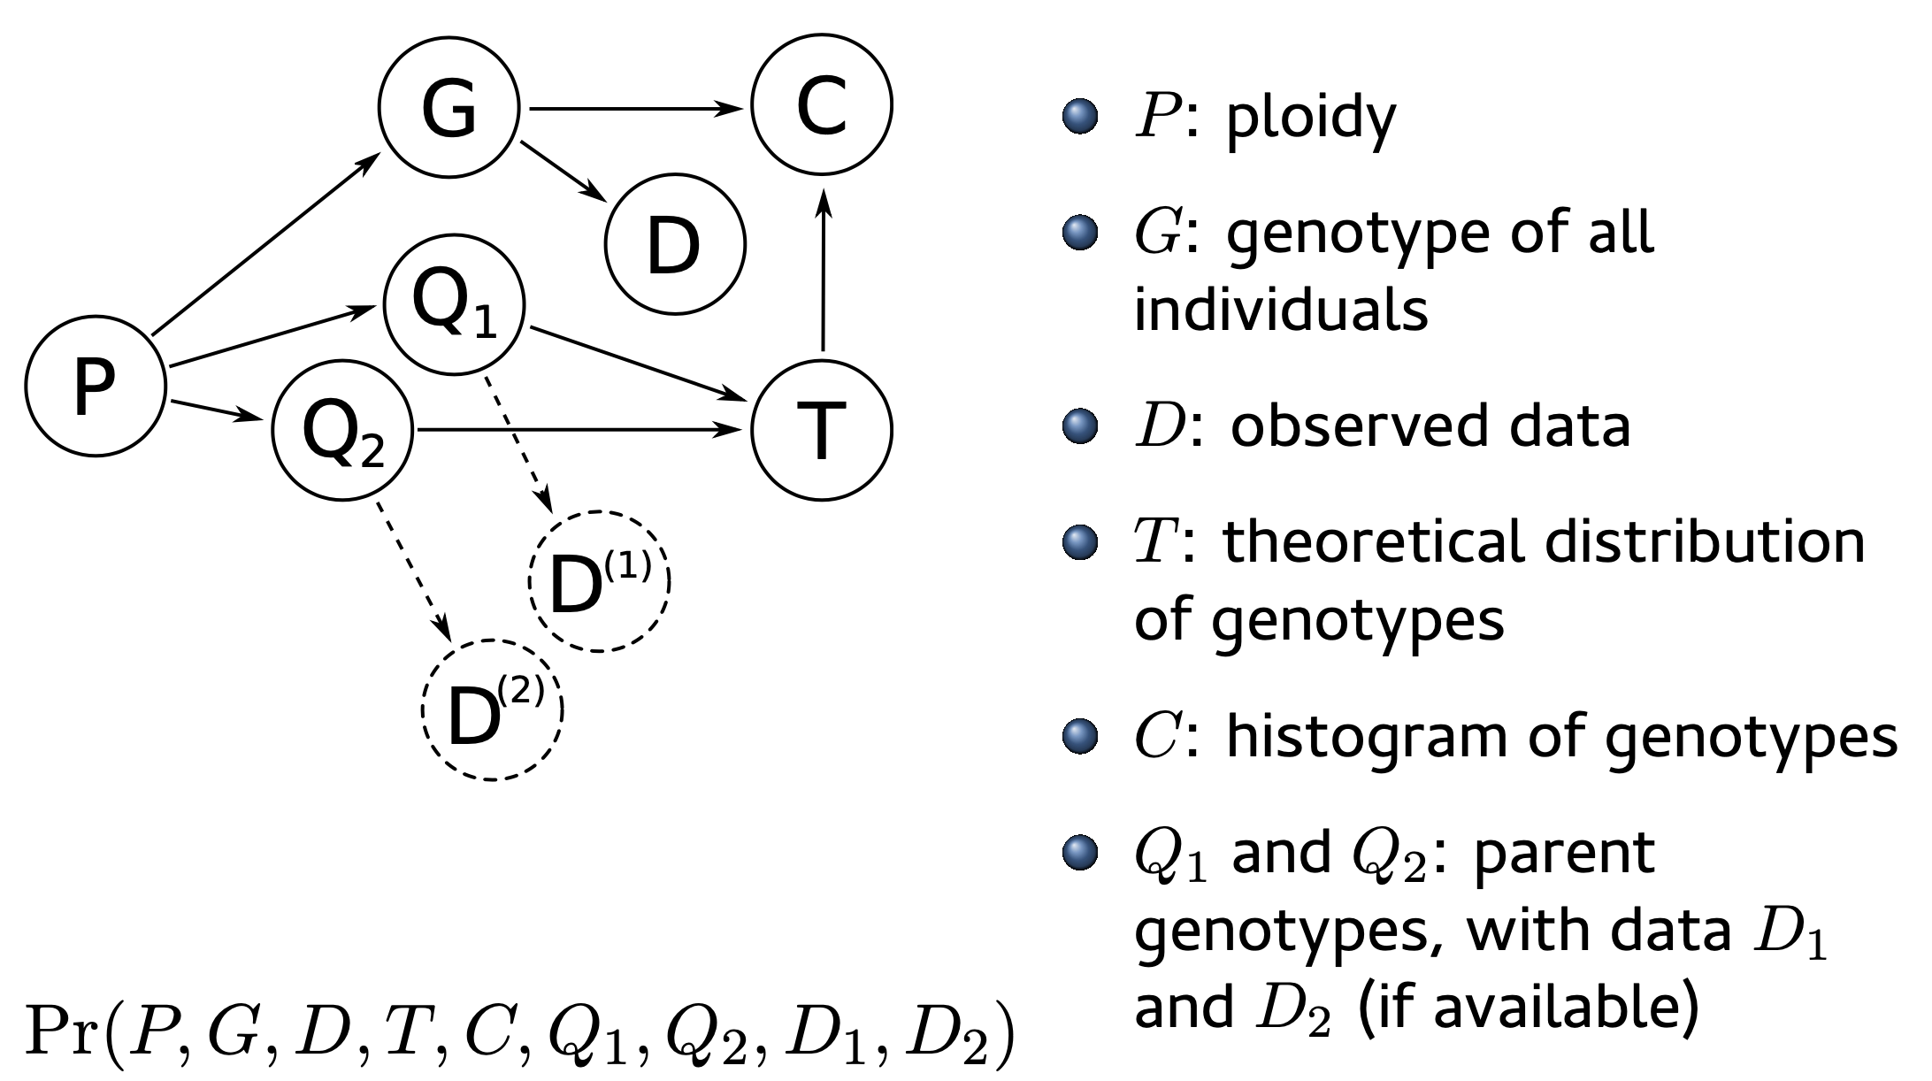
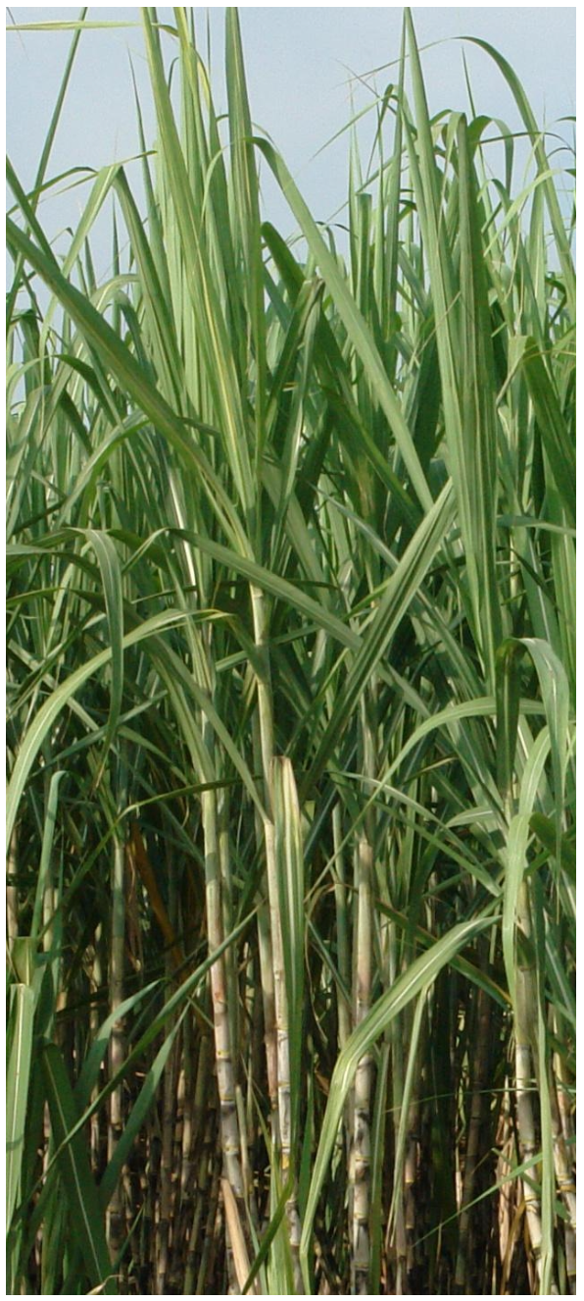
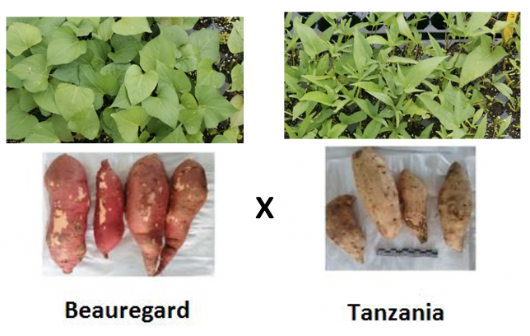
Outline
Introduction to the model
Ploidy estimation in a sugarcane biparental population
Genotype calling in a sweetpotato biparental population using VCF2SM

Slide 3
SuperMASSA’s probabilistic graphical model
SuperMASSA is a software developed to infer ploidy levels and perform genotype calling using dosage-based molecular markers
It uses the ratio between the abundance of two allelic variants in probabilistic graphical model to compute the maximum a posteriori configuration of the network
Two sets of information
Observations
D: offspring’s observed data
D₁ and D₂ : parental observed data (if available)
C: observed distribution of the genotypes
Theory
P: ploidy
G: genotype of all individuals
T: expected segregation

Slide 4
Probabilistic graphical model

Slide 5
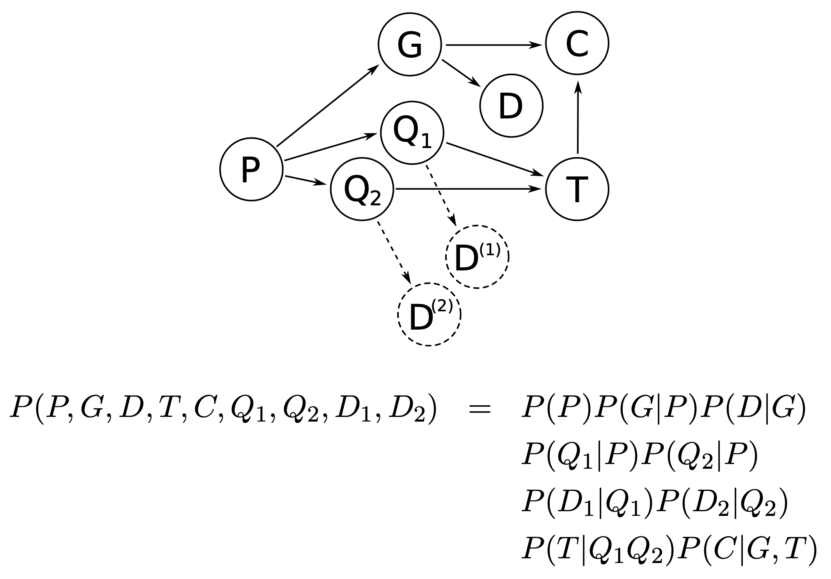
Probabilistic graphical model
Maximum a posteriori configuration: It is the configuration (set of assignments) that maximizes the joint probability of the network, given the evidences (observed data)

Slide 6
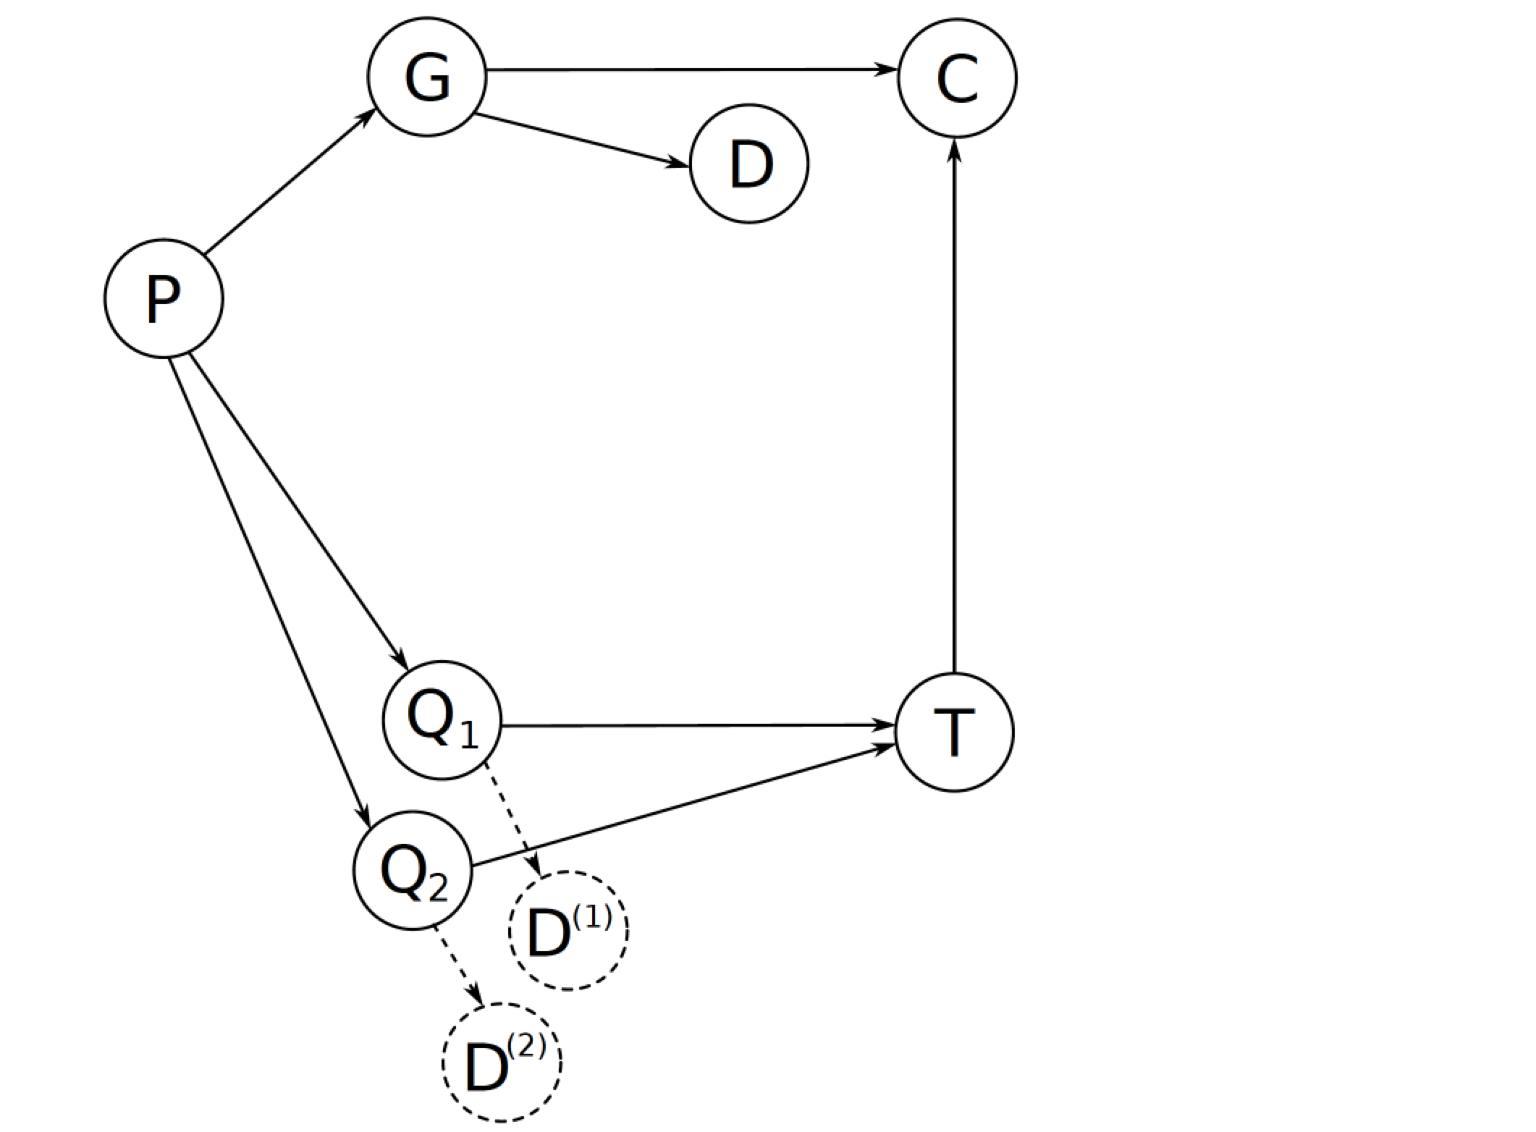
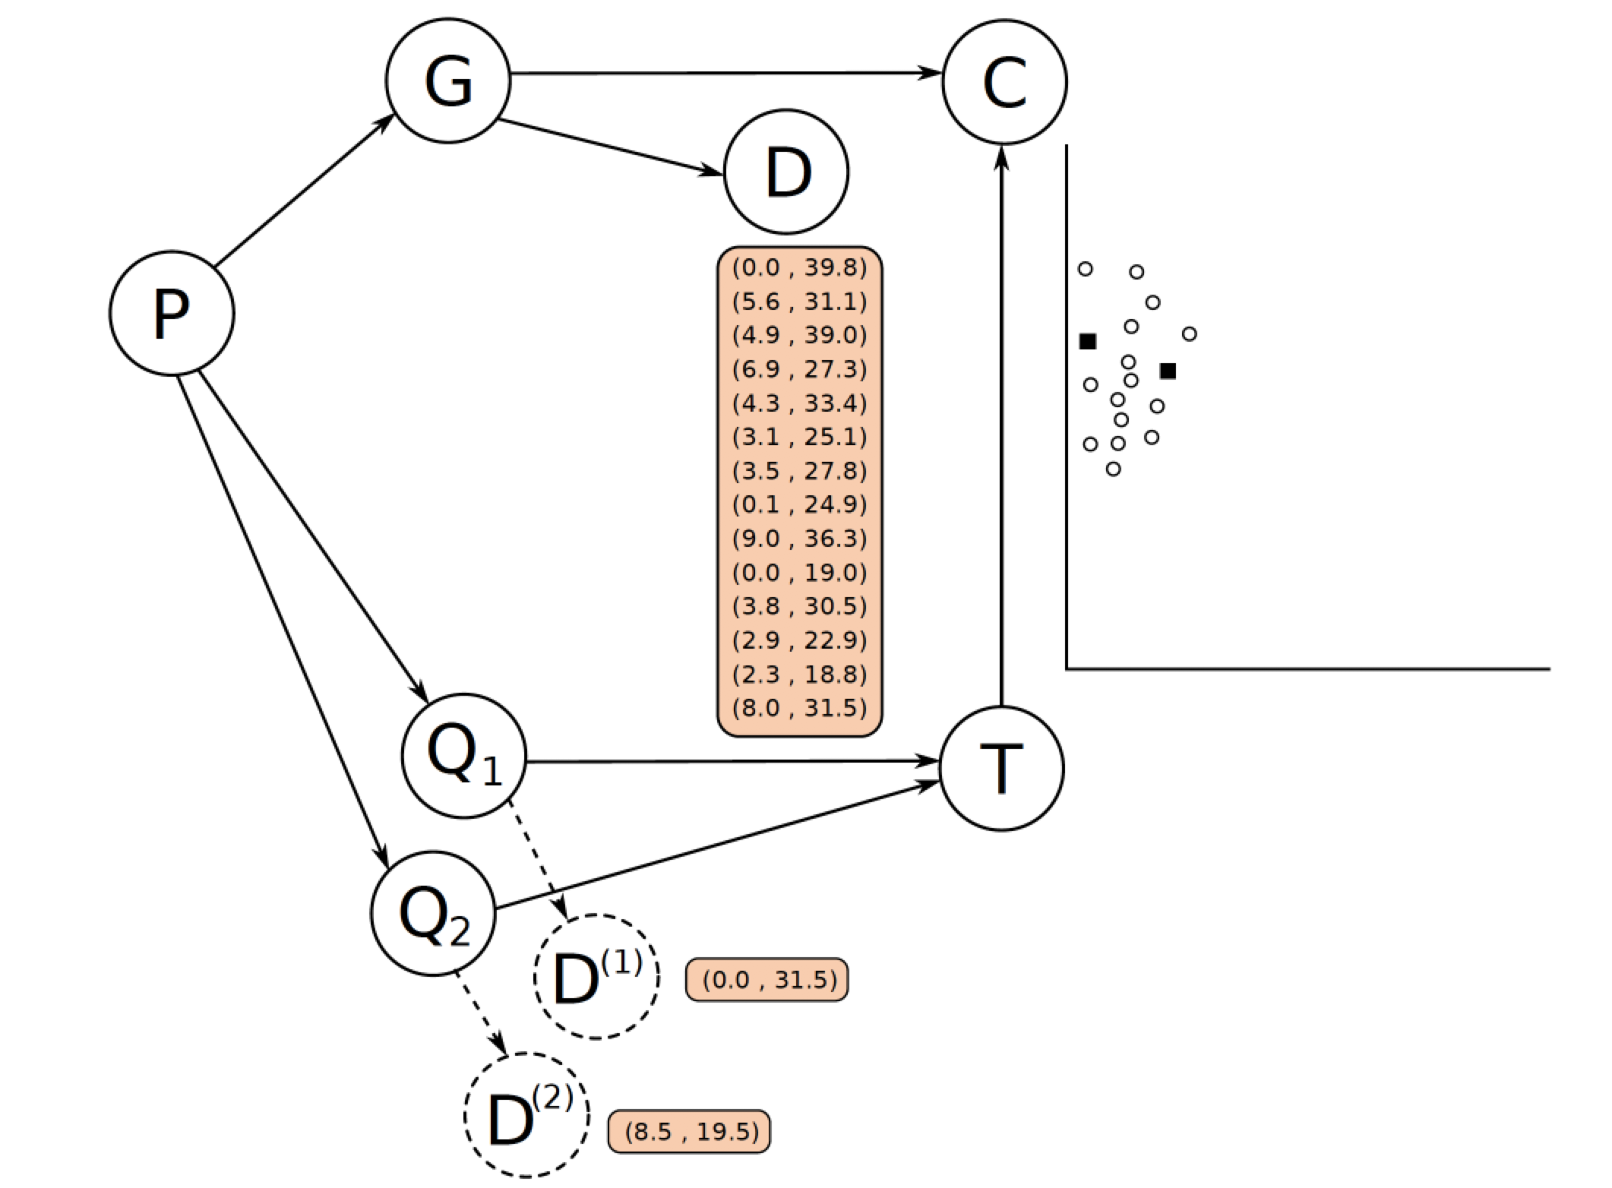
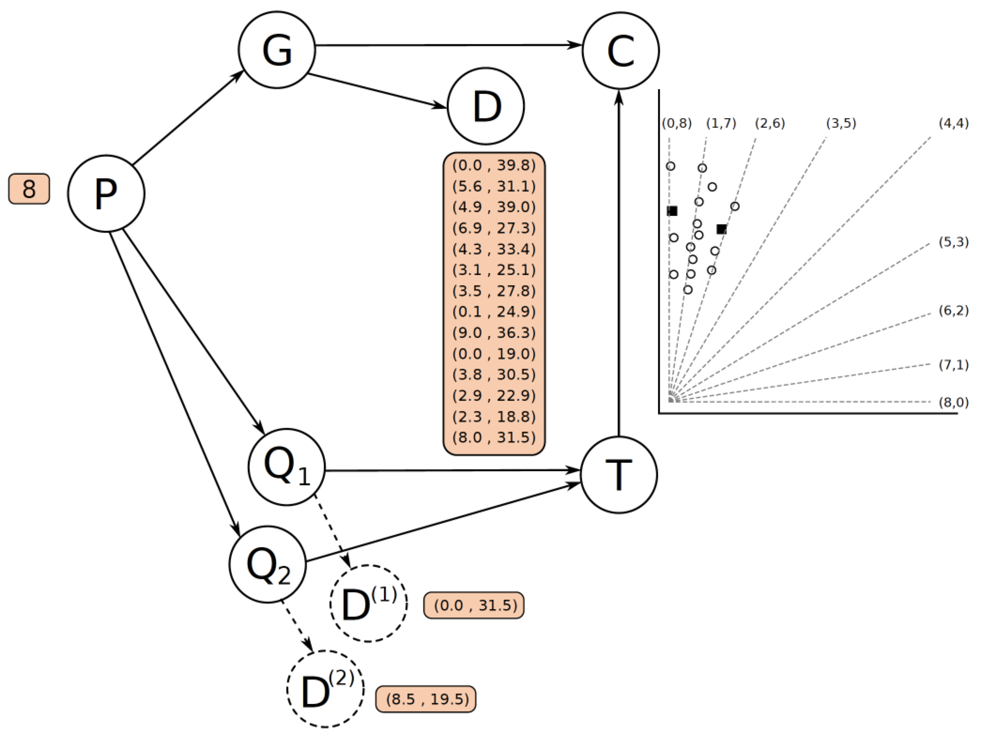
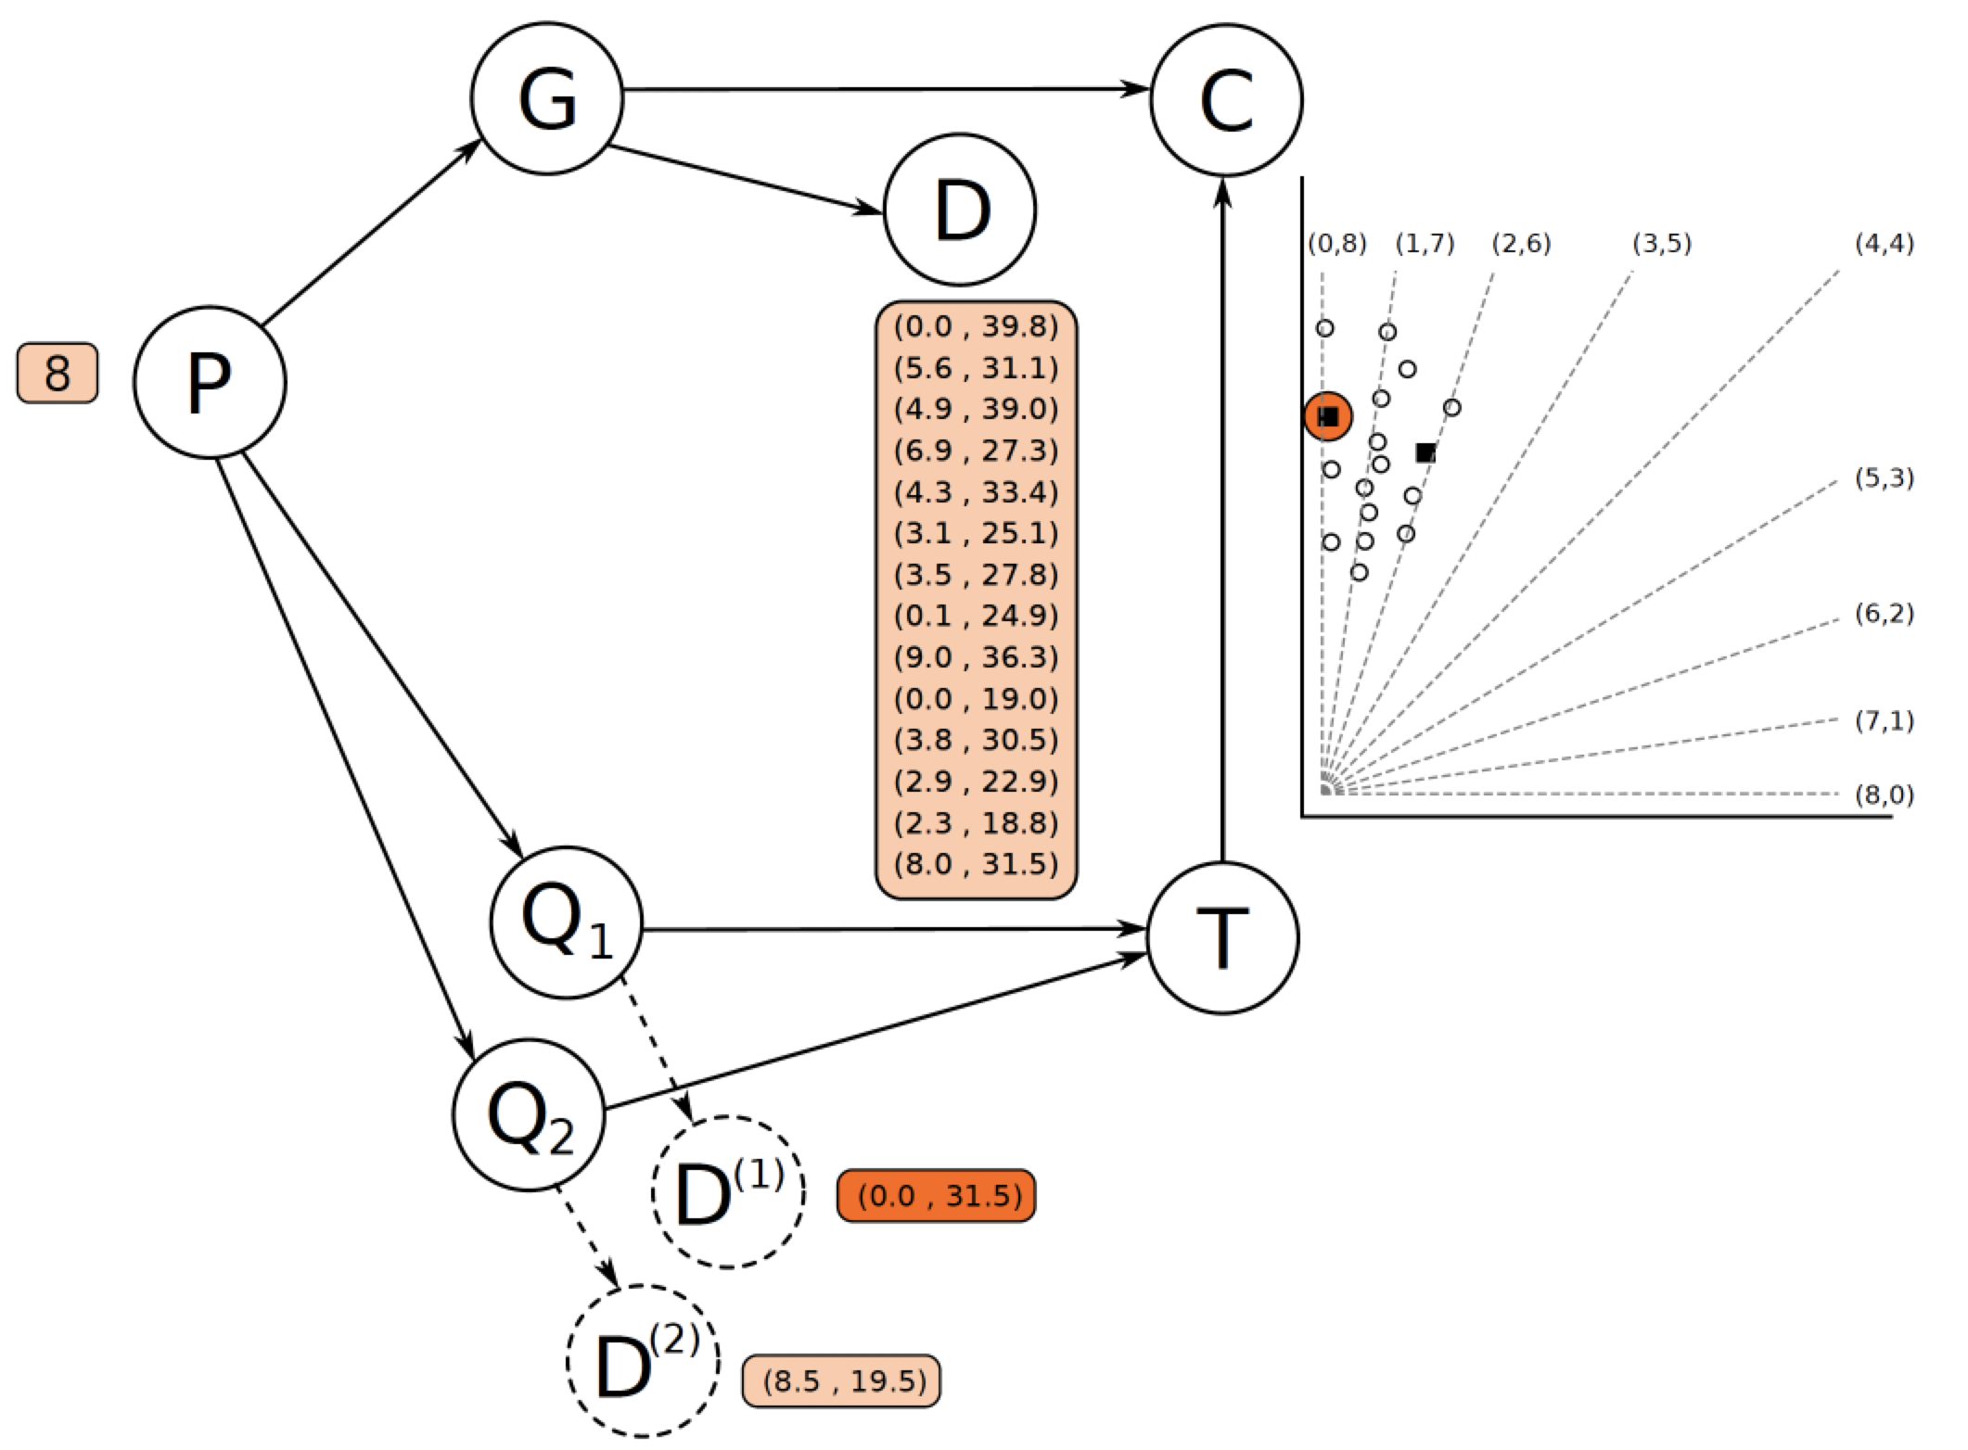
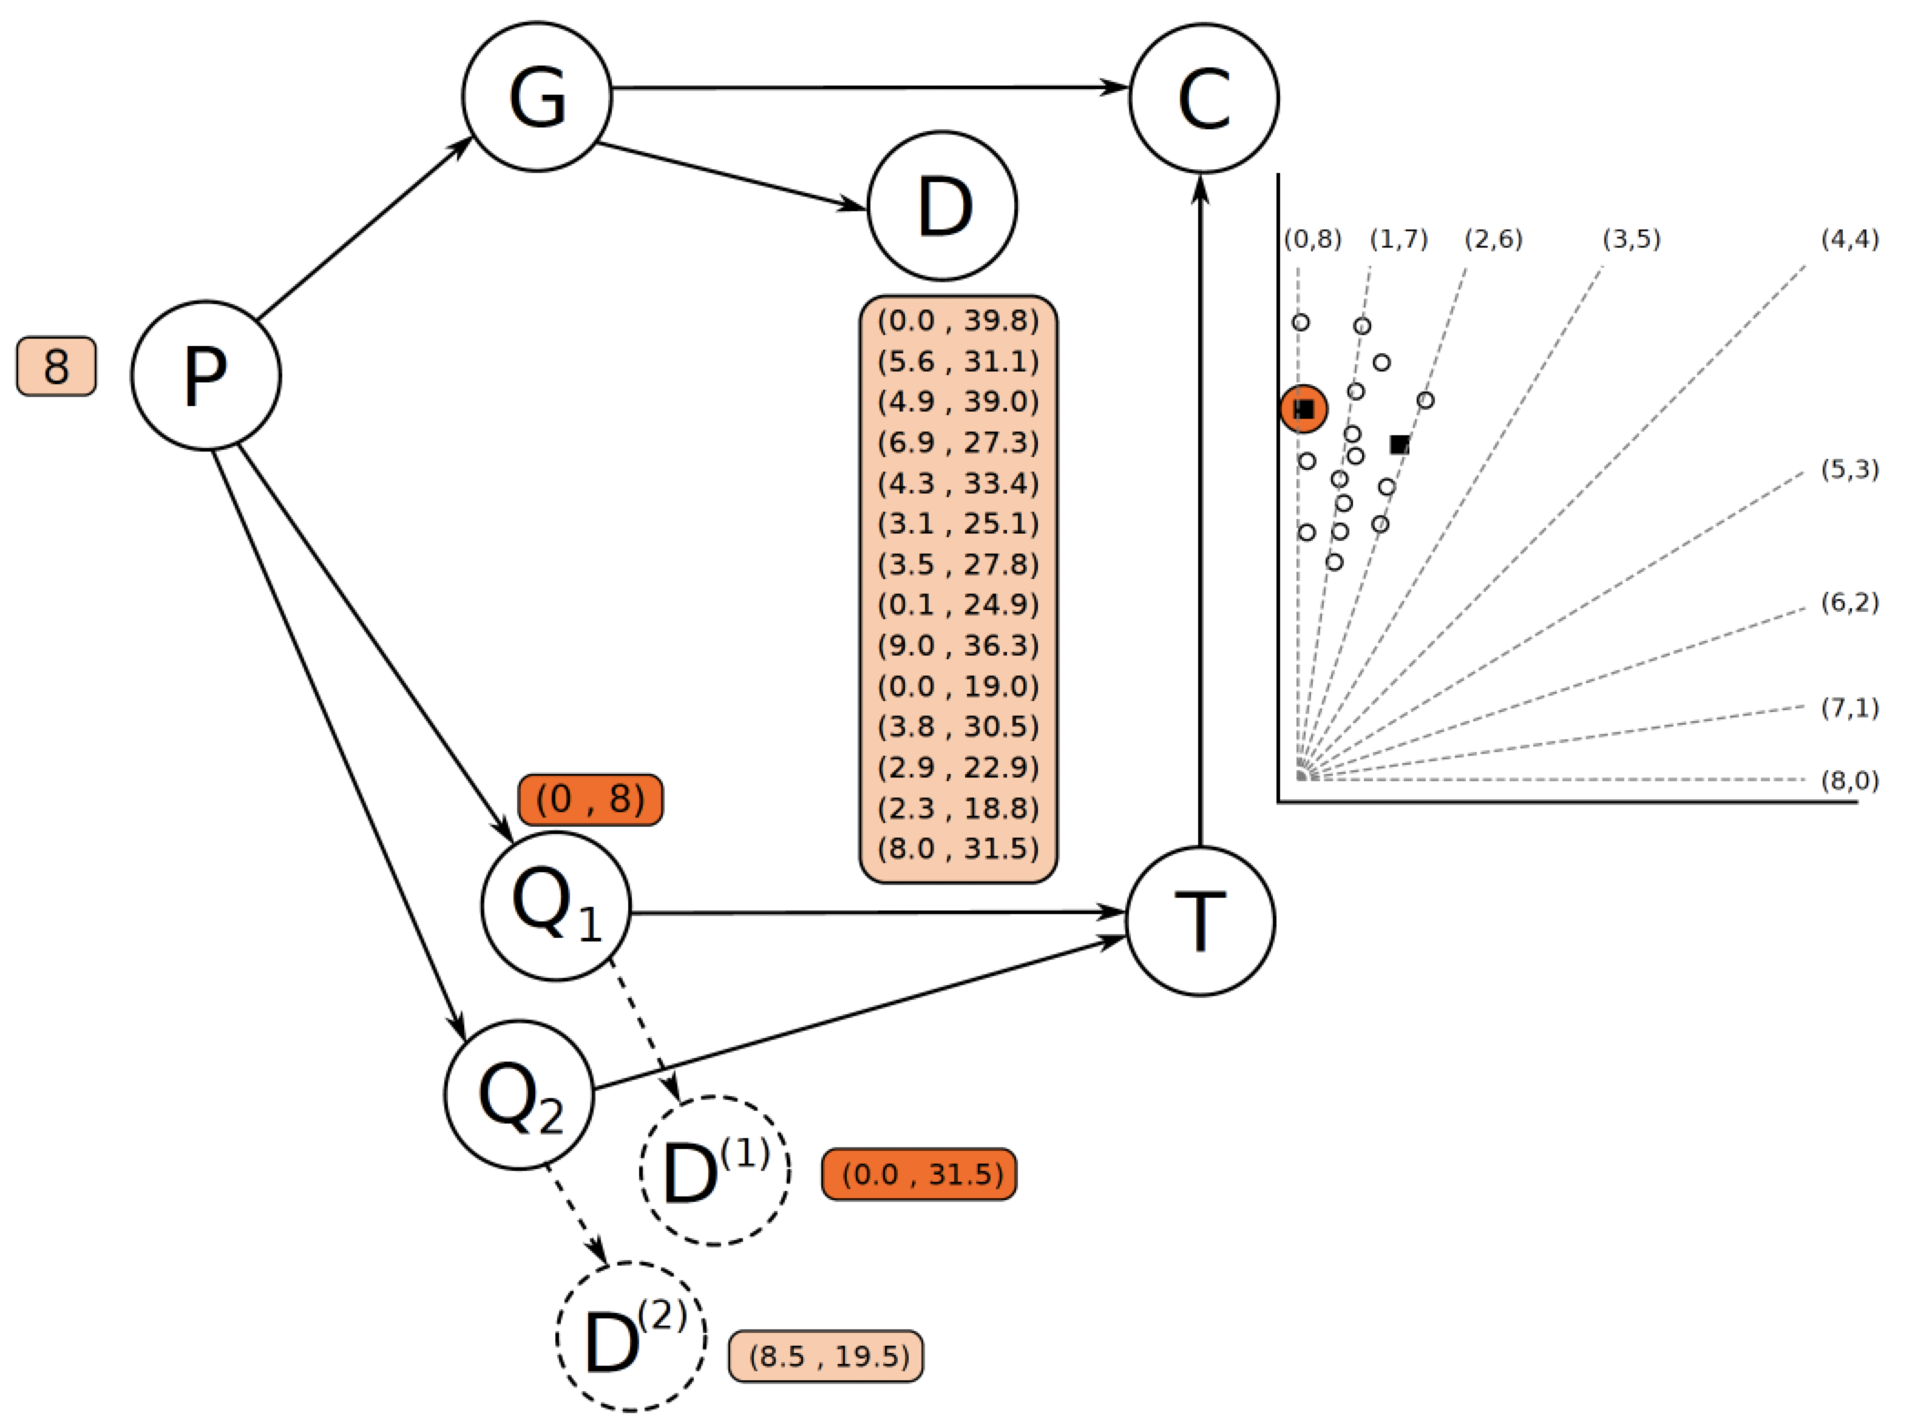
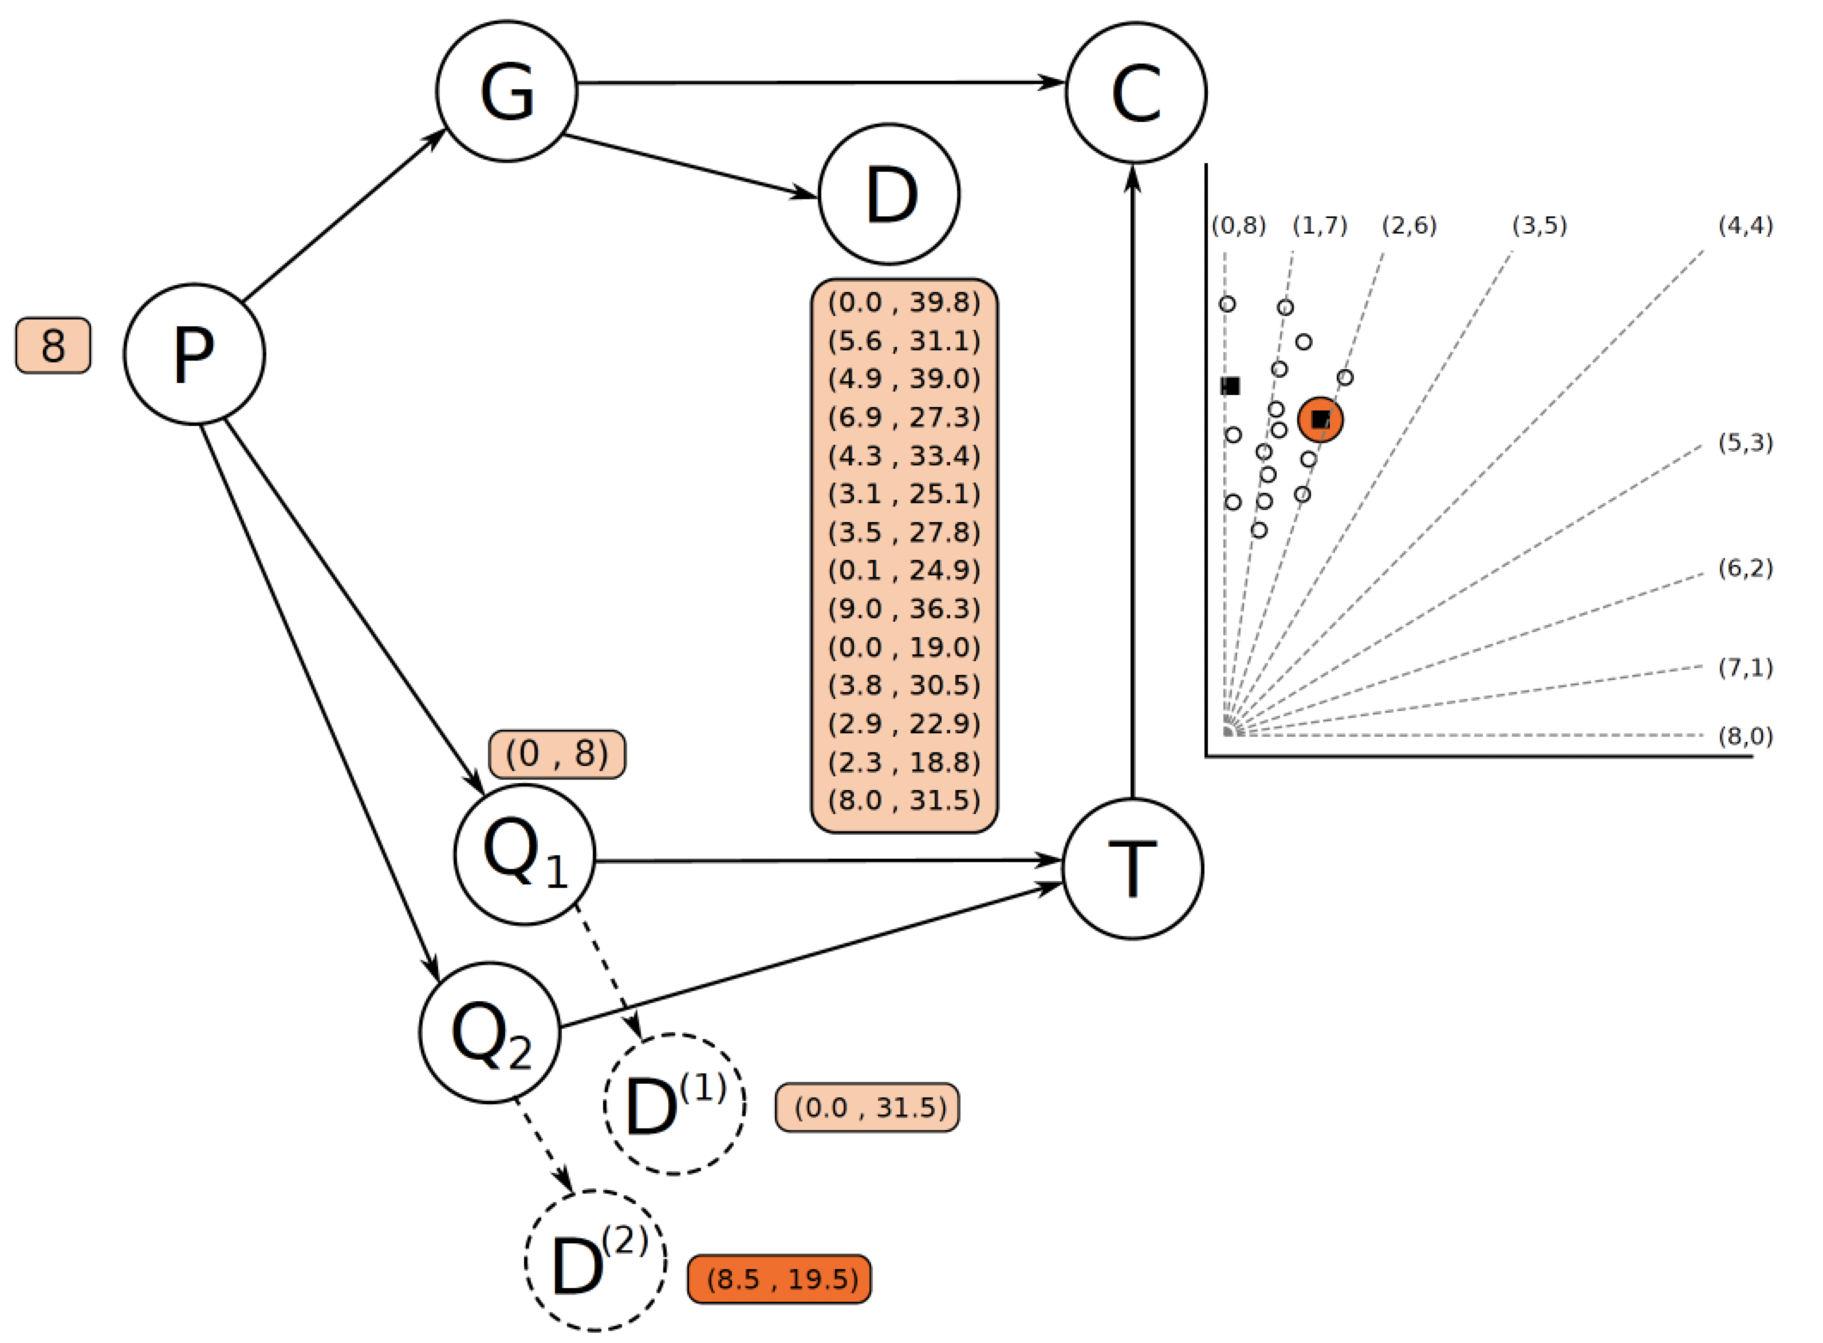
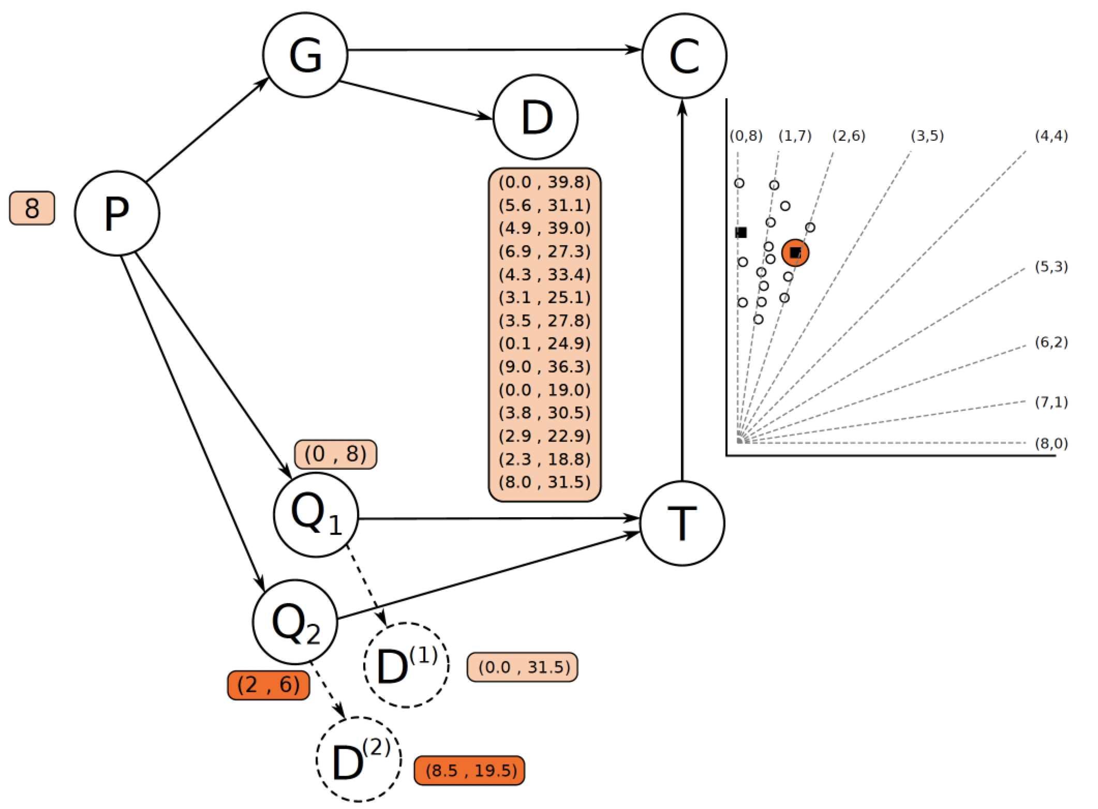
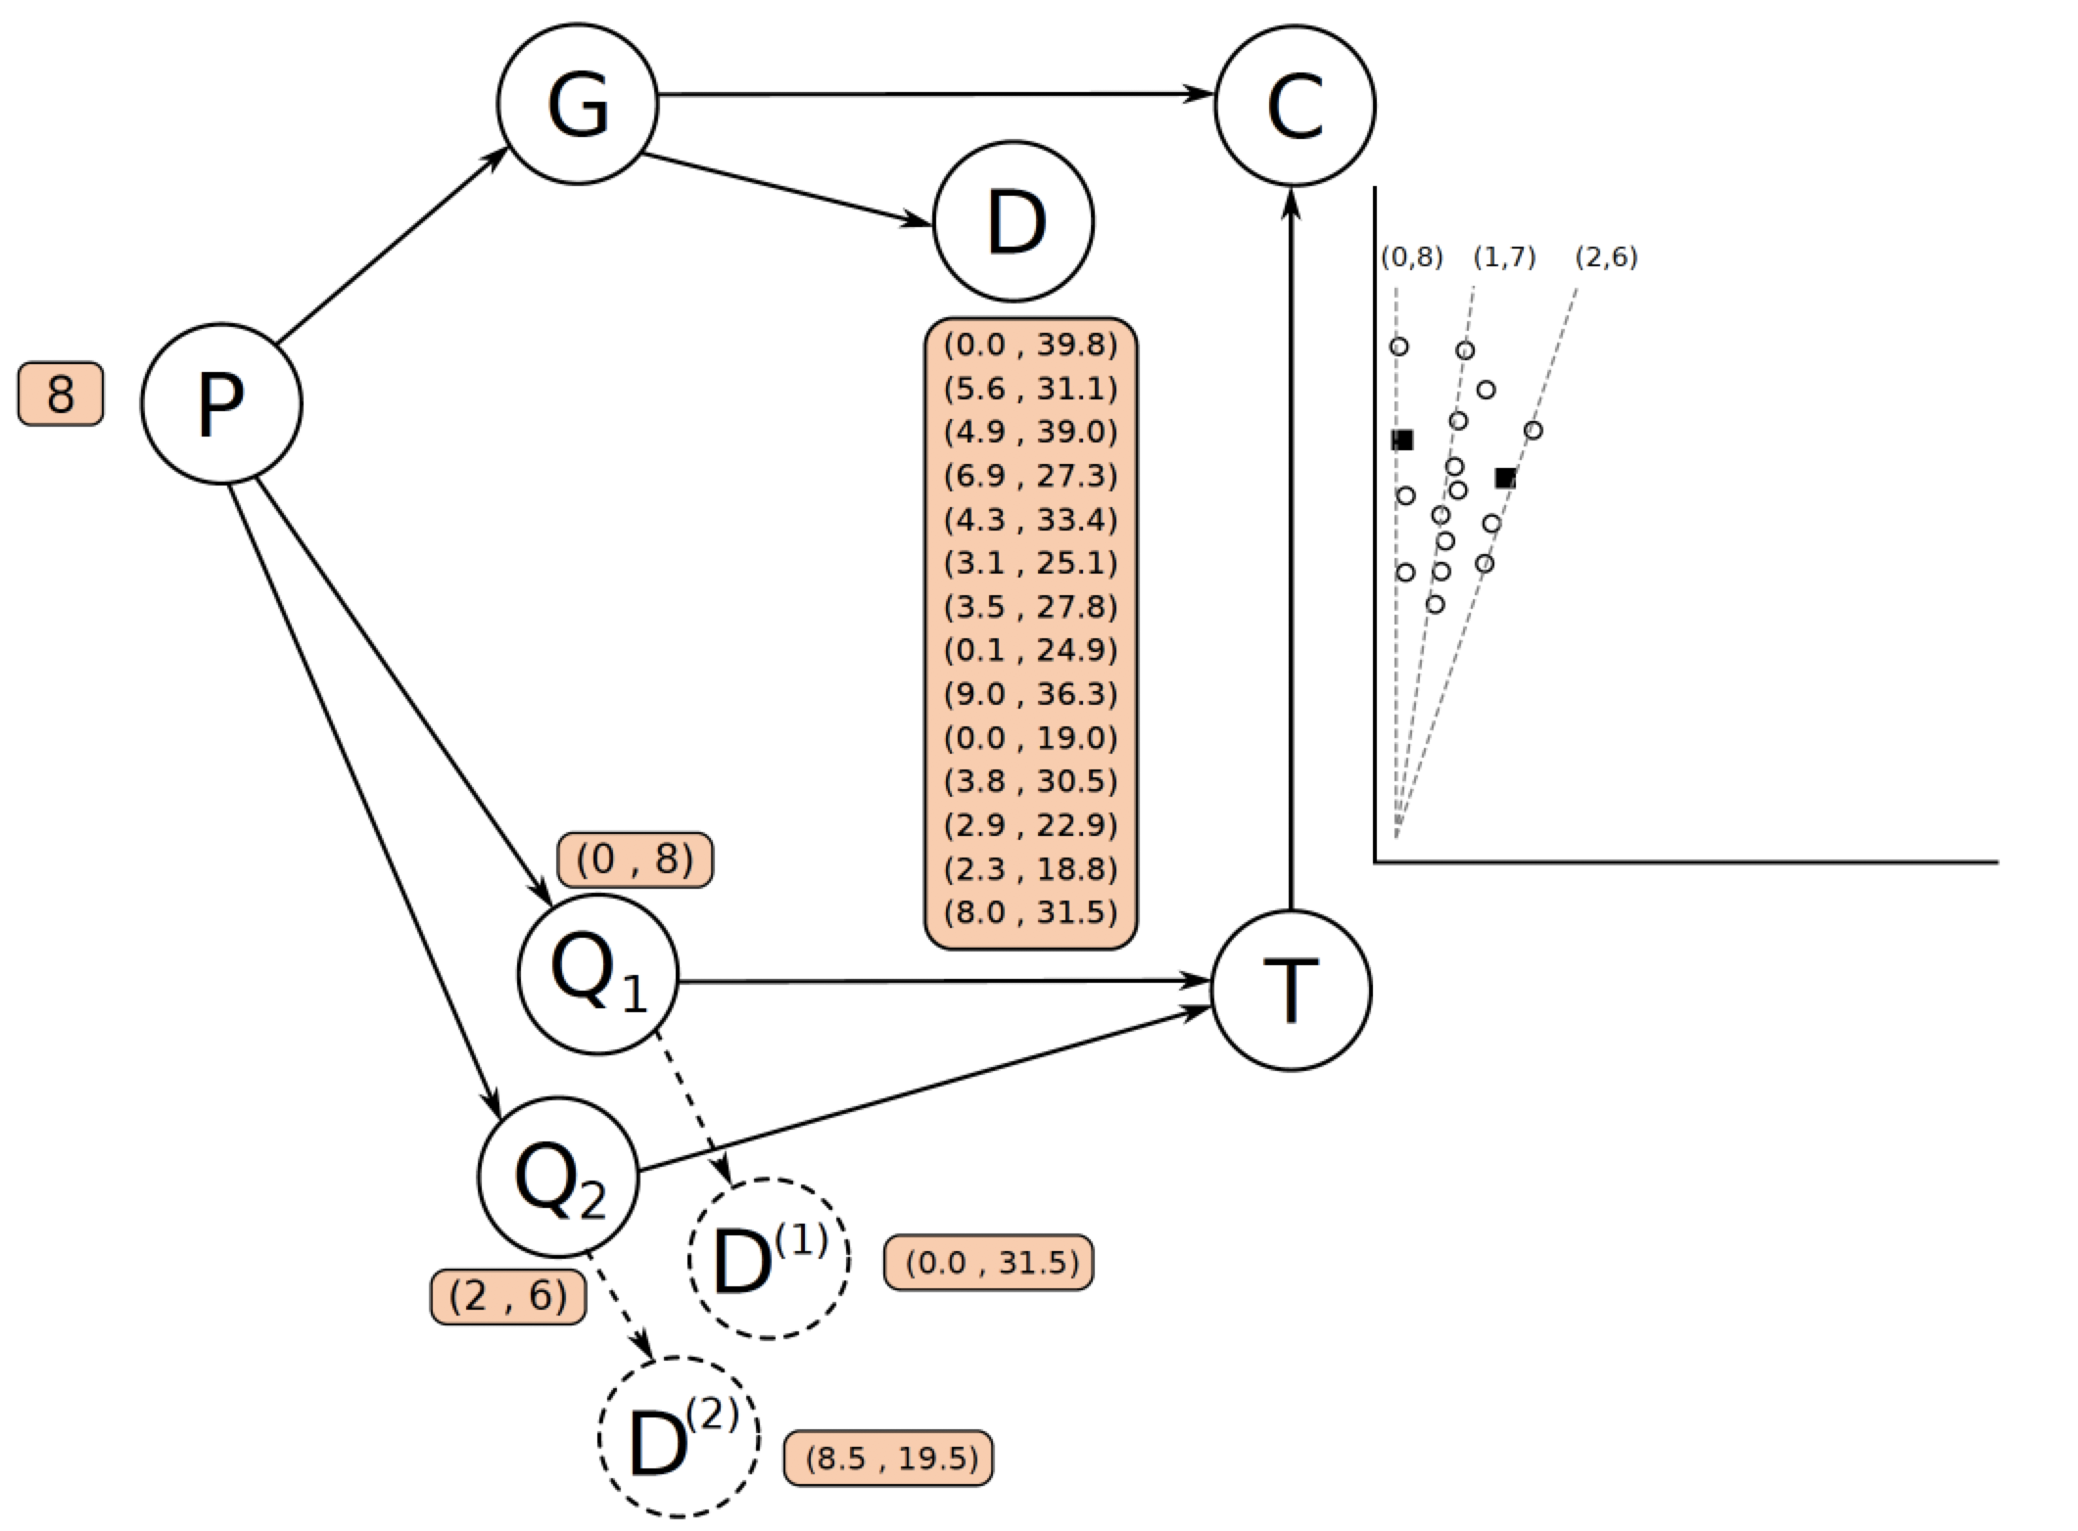
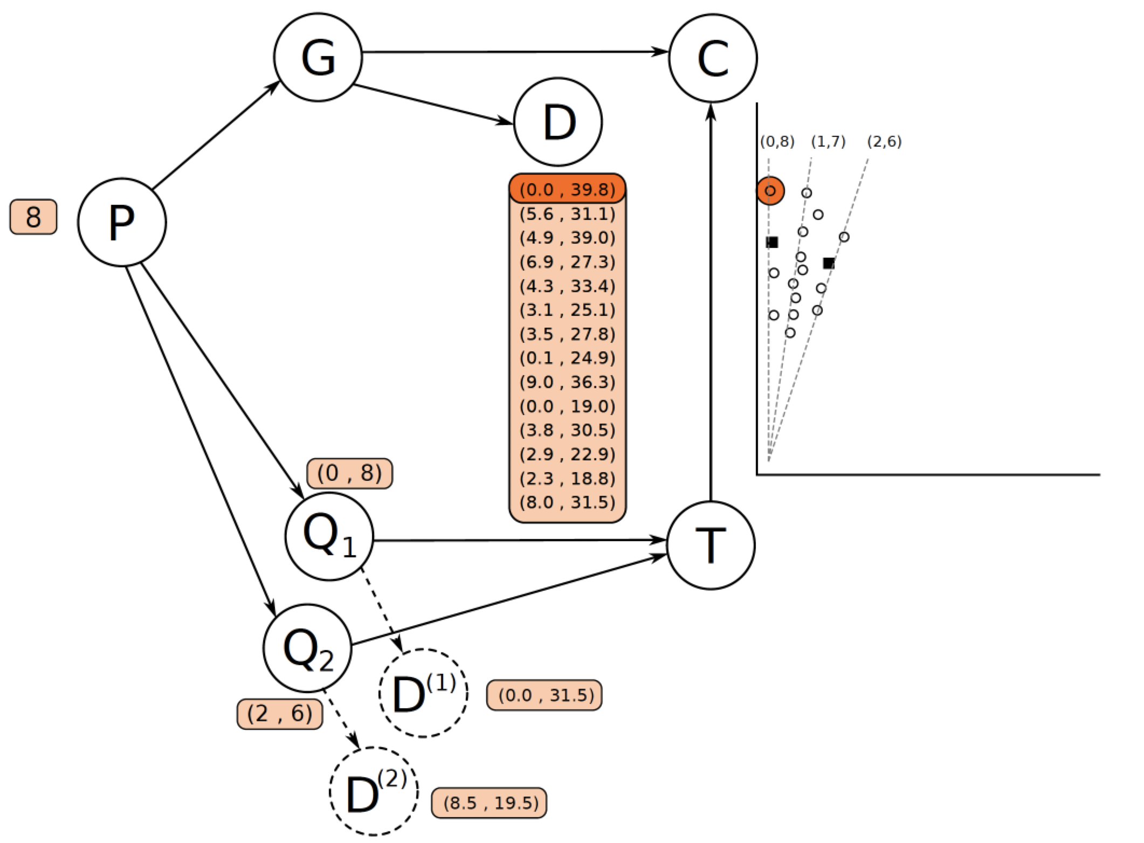
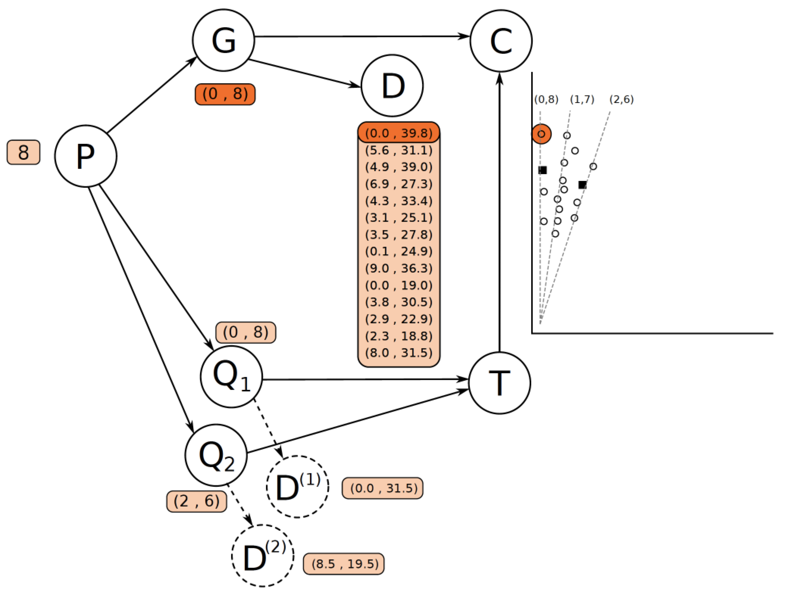
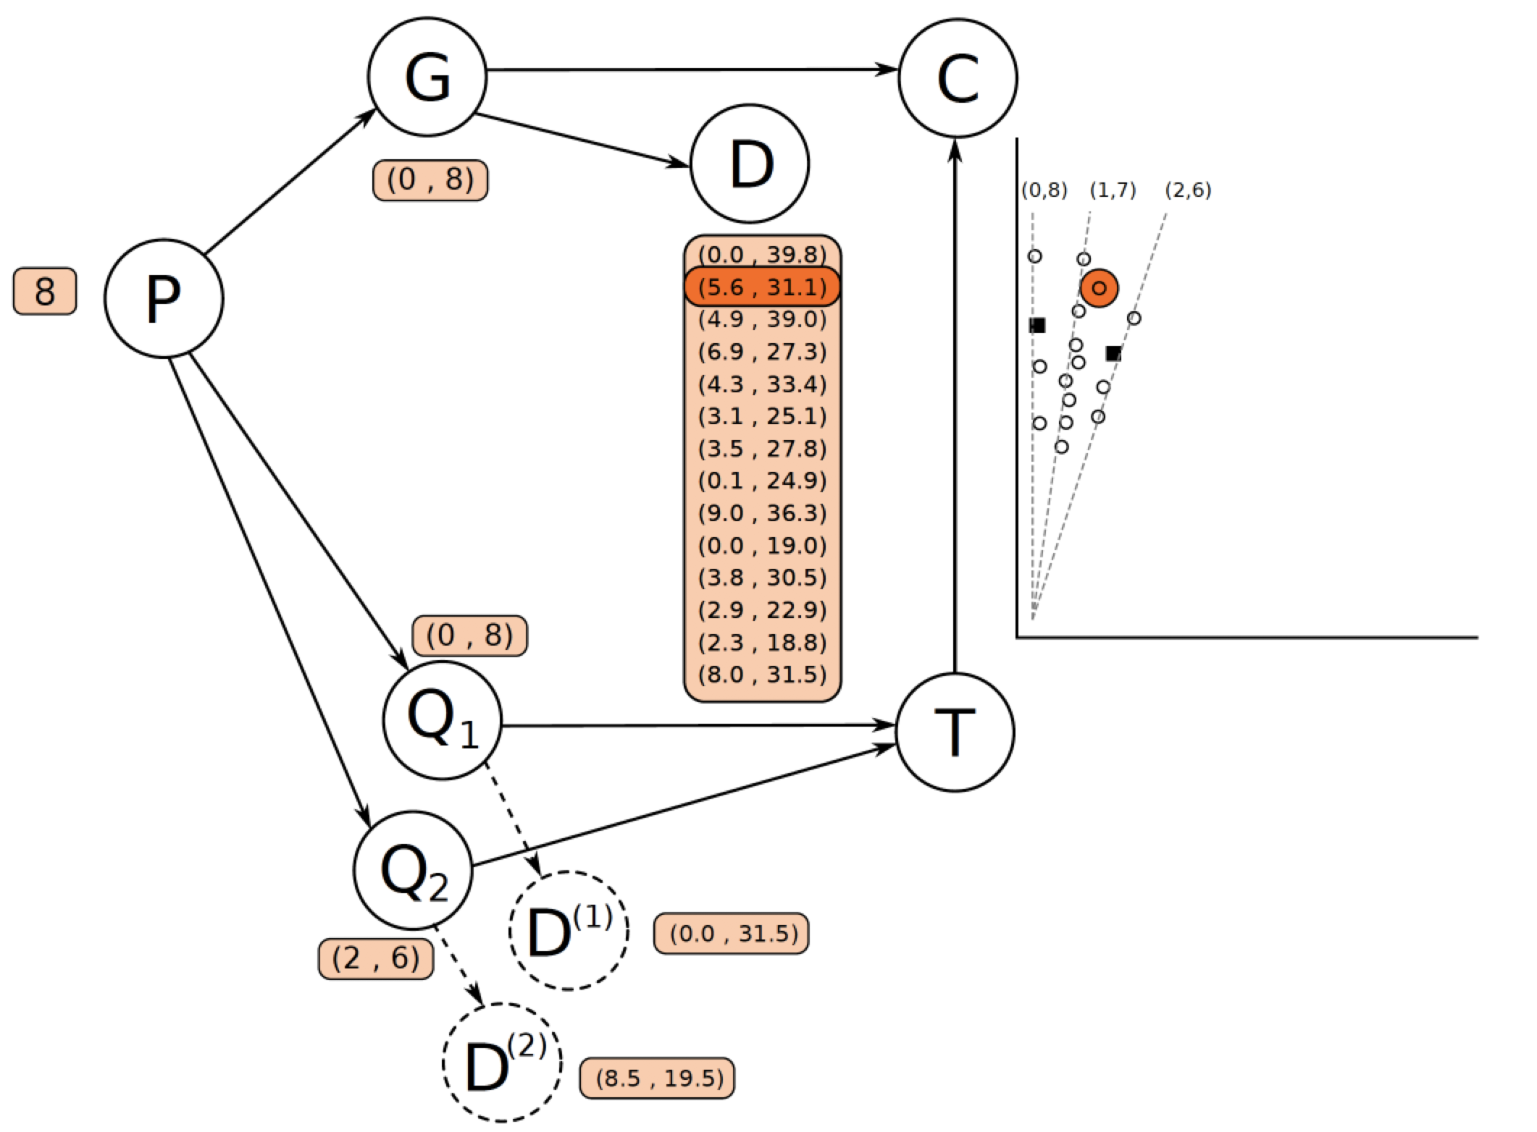
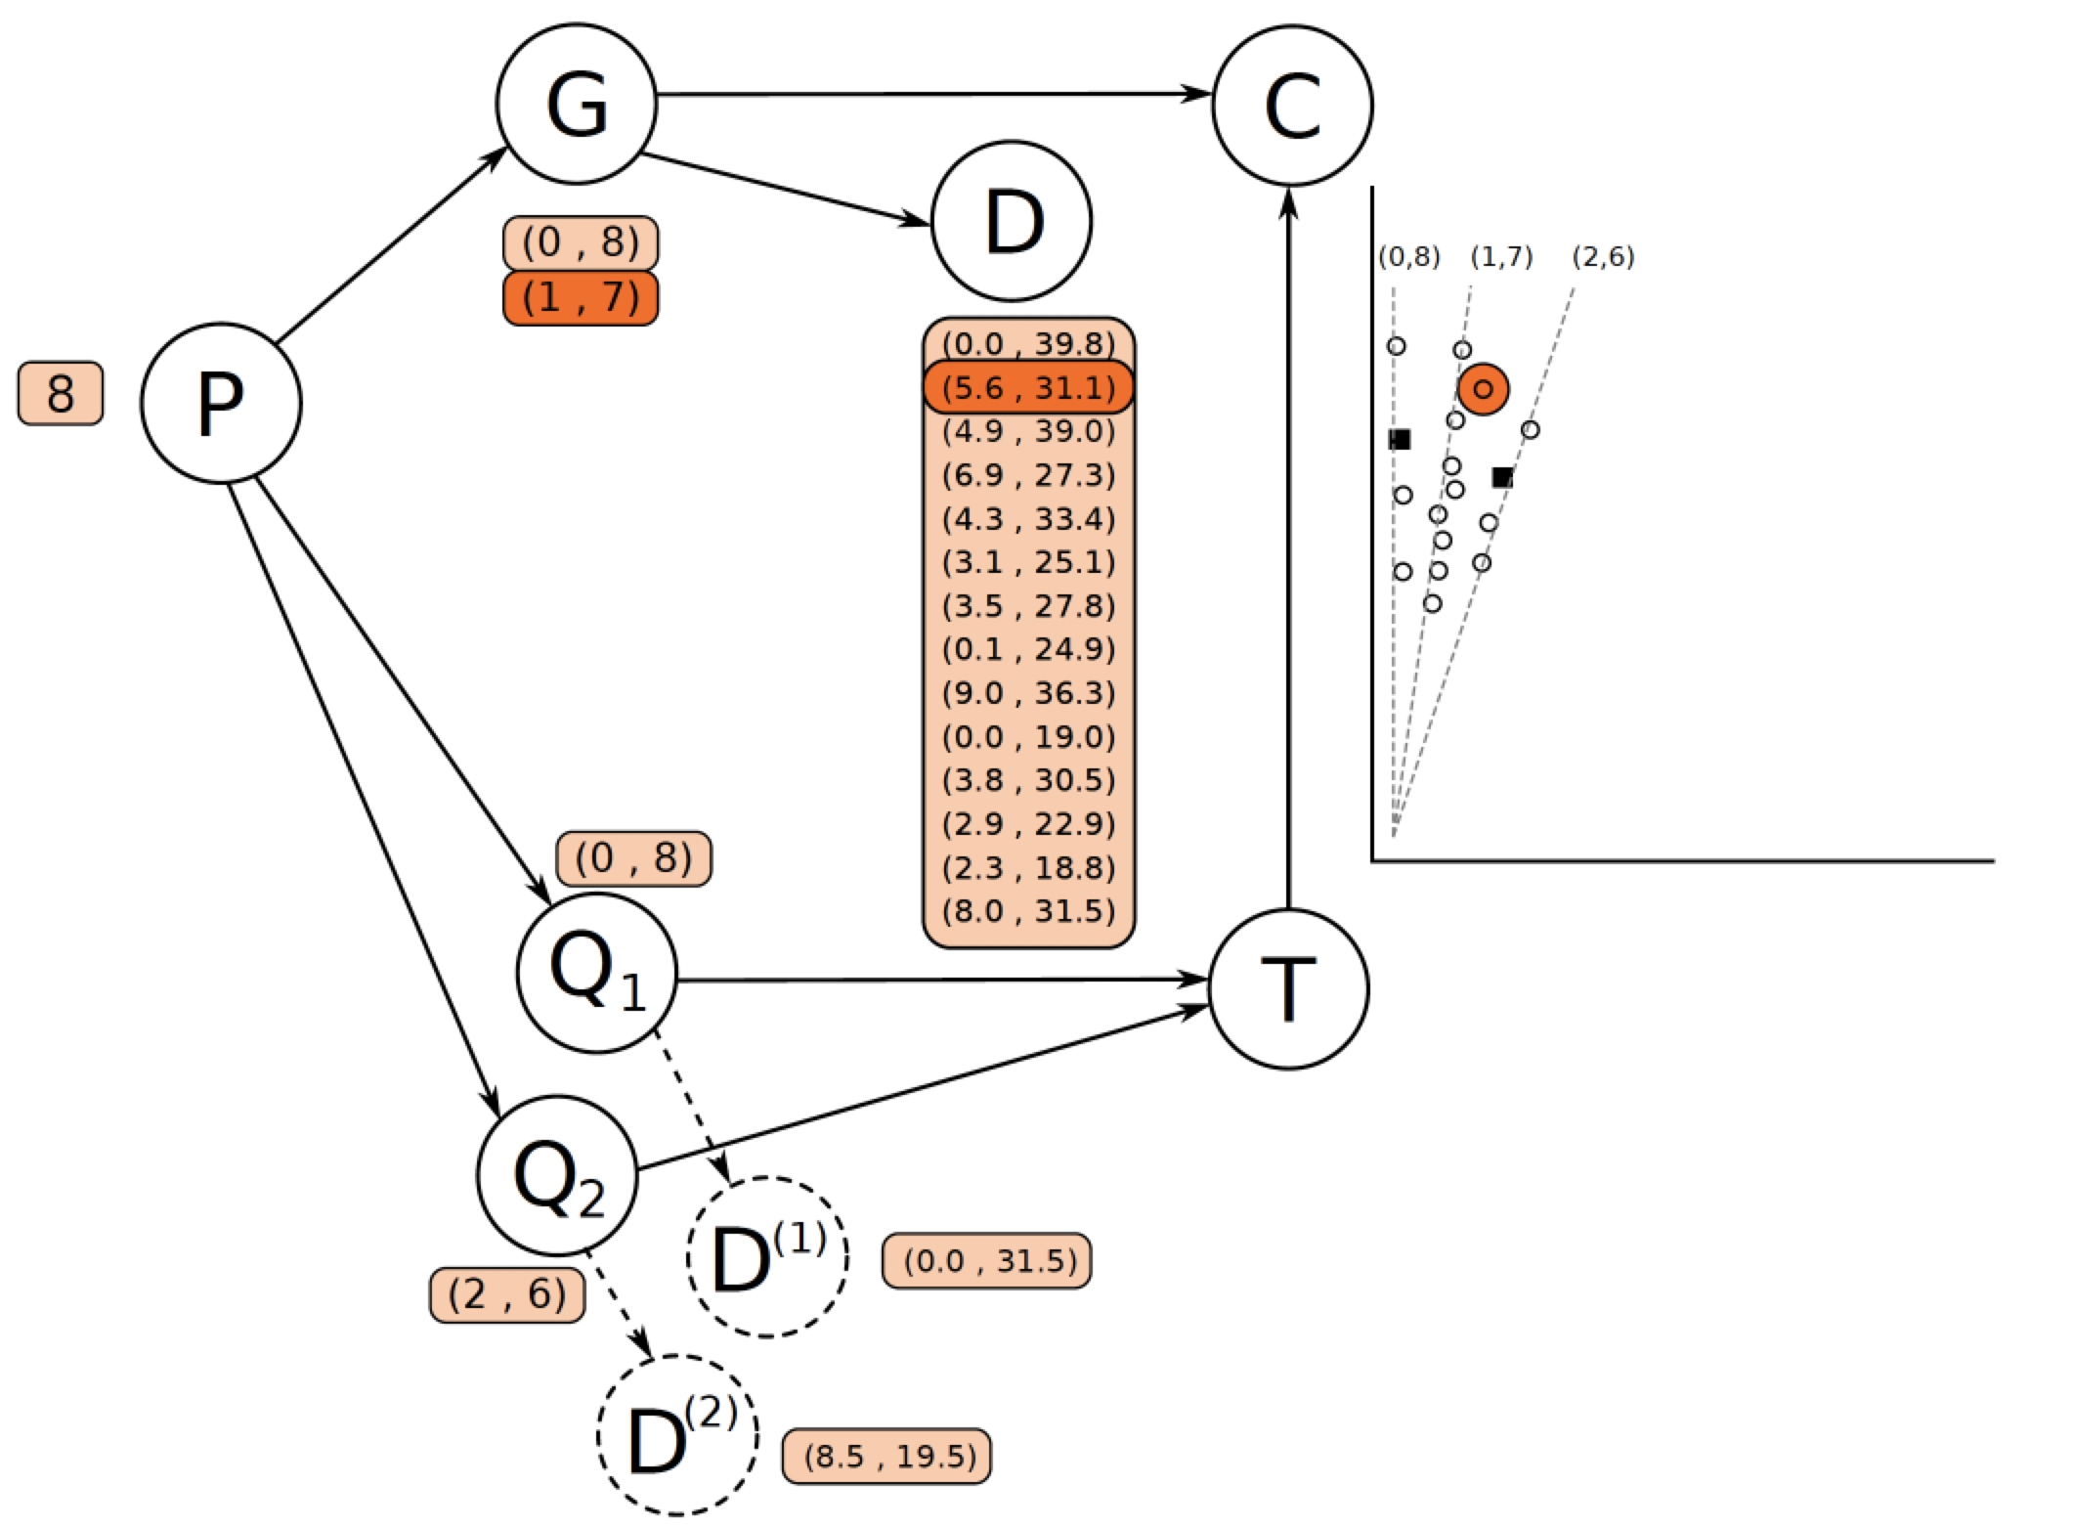
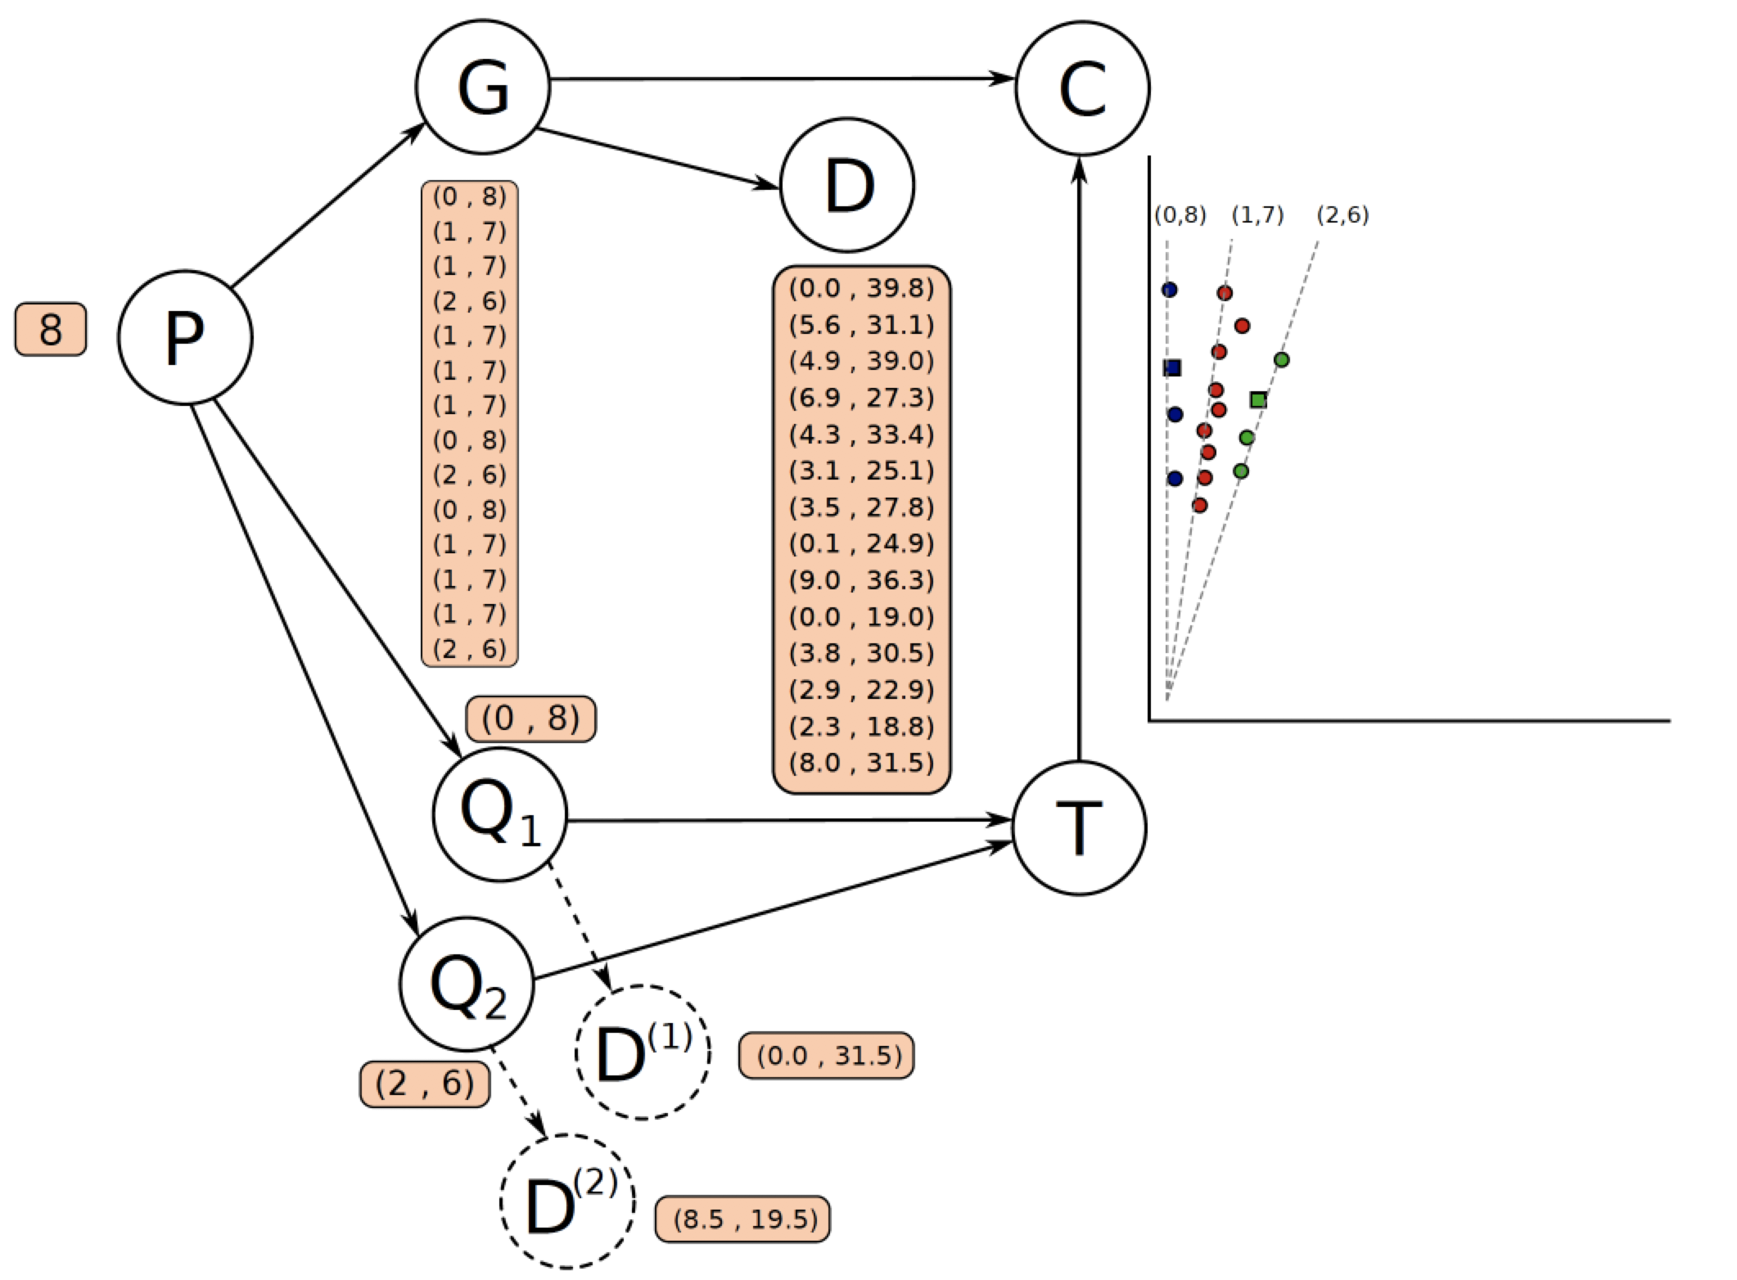
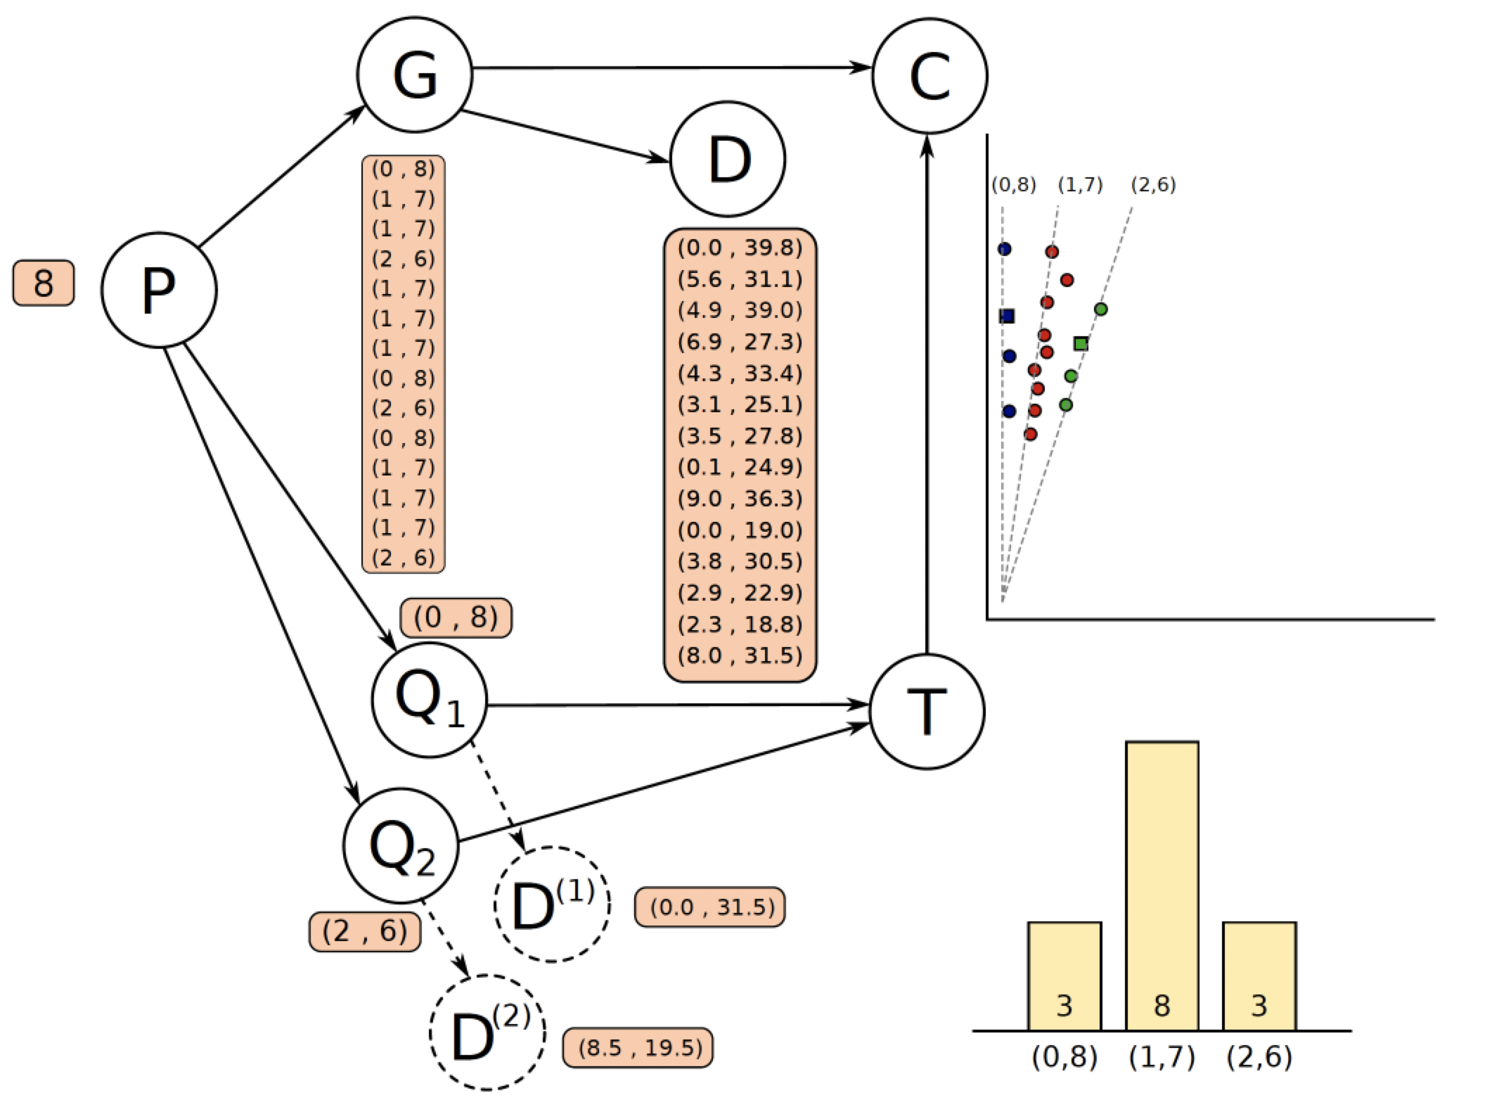
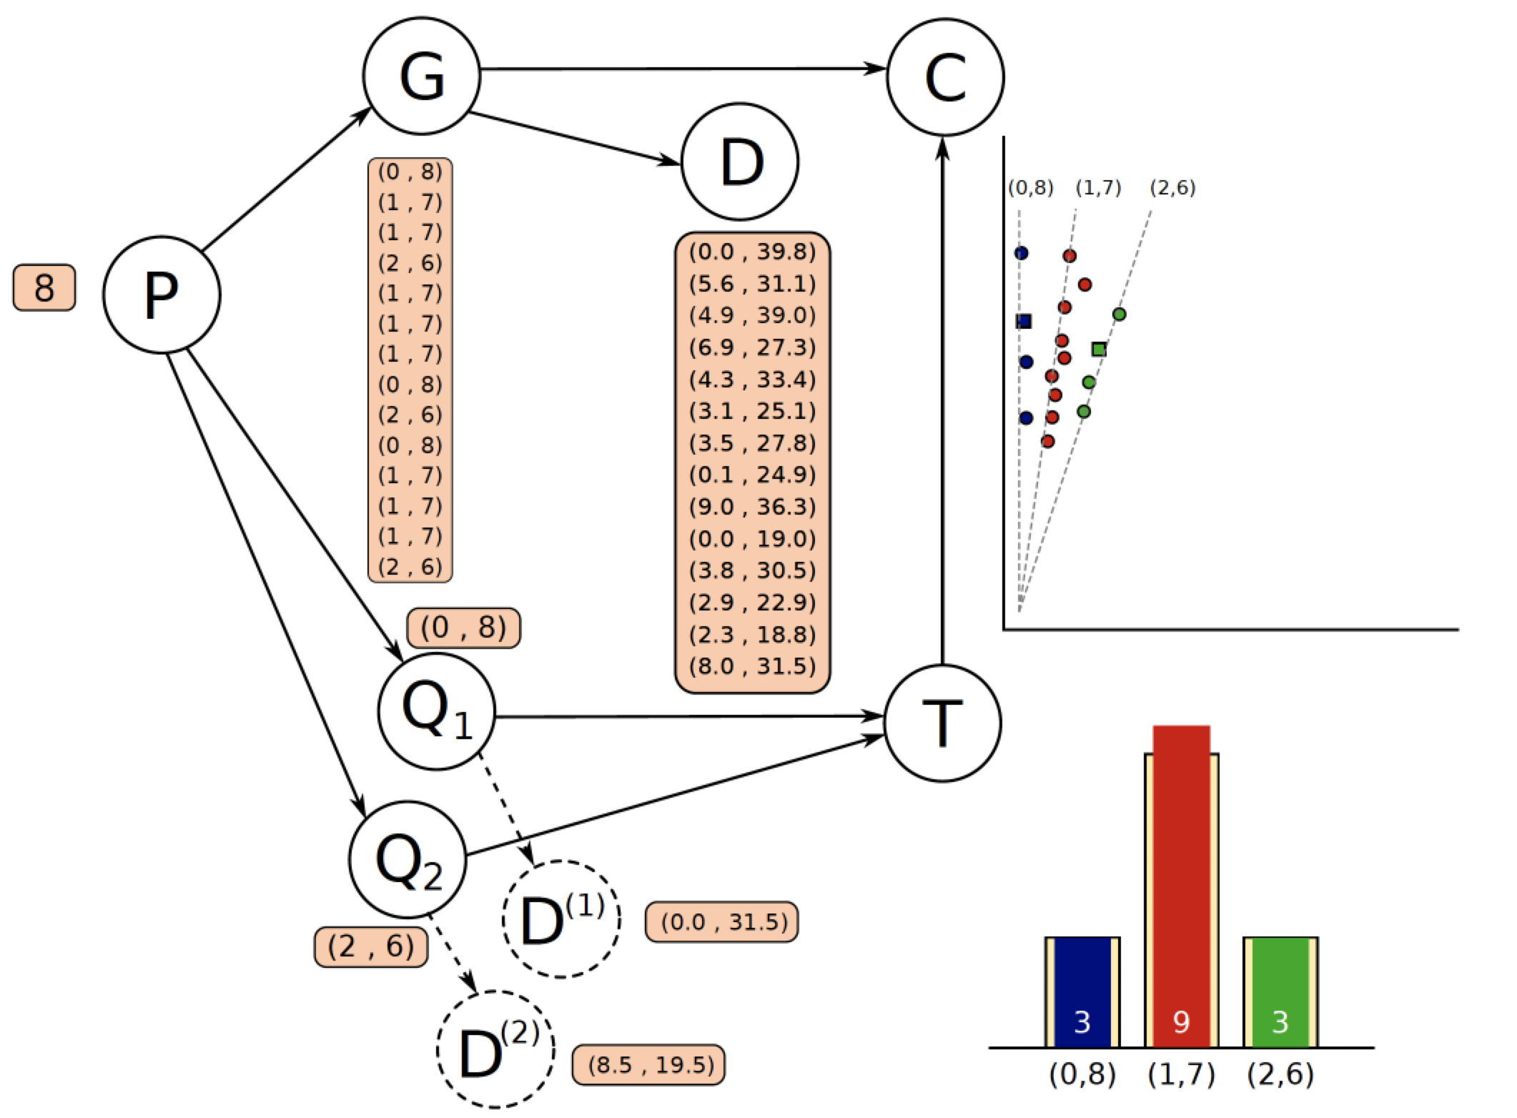
Probabilistic graphical model

Slide 7
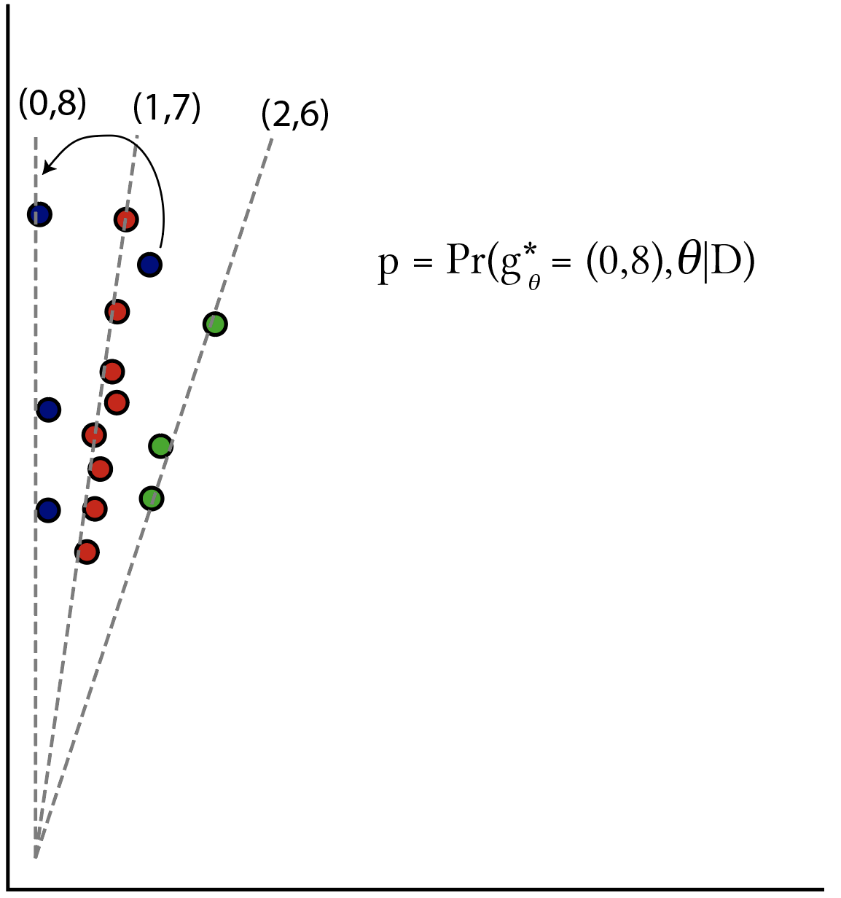
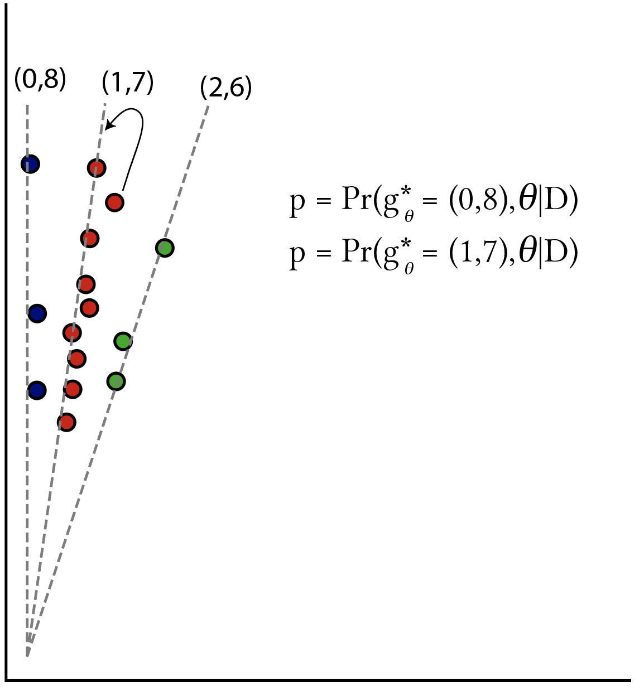
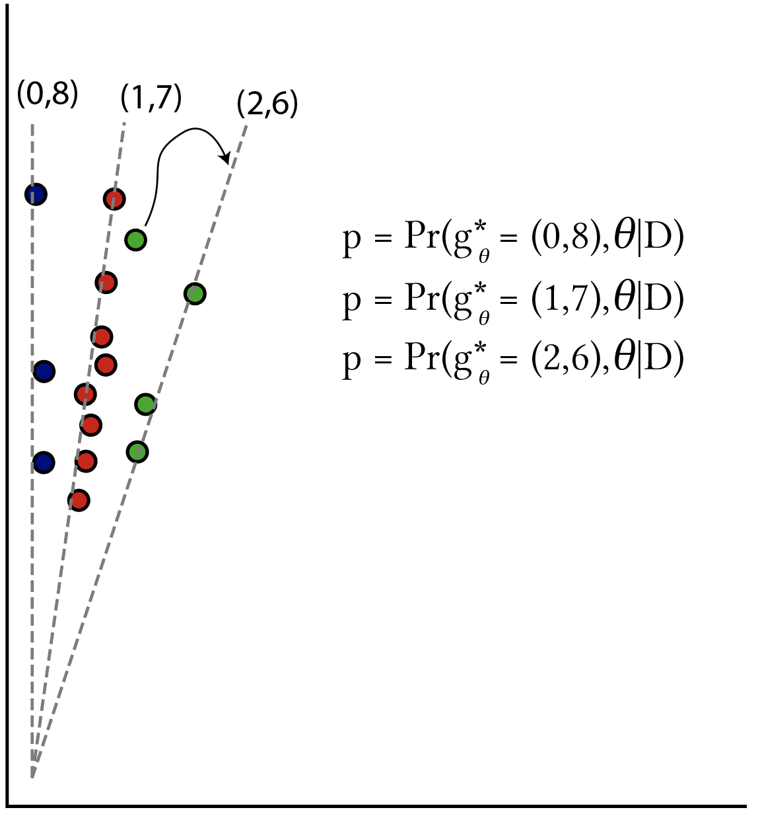
Individual (naïve) probabilities
Posterior estimates that individuals are assigned to the correct genotype

Slide 8

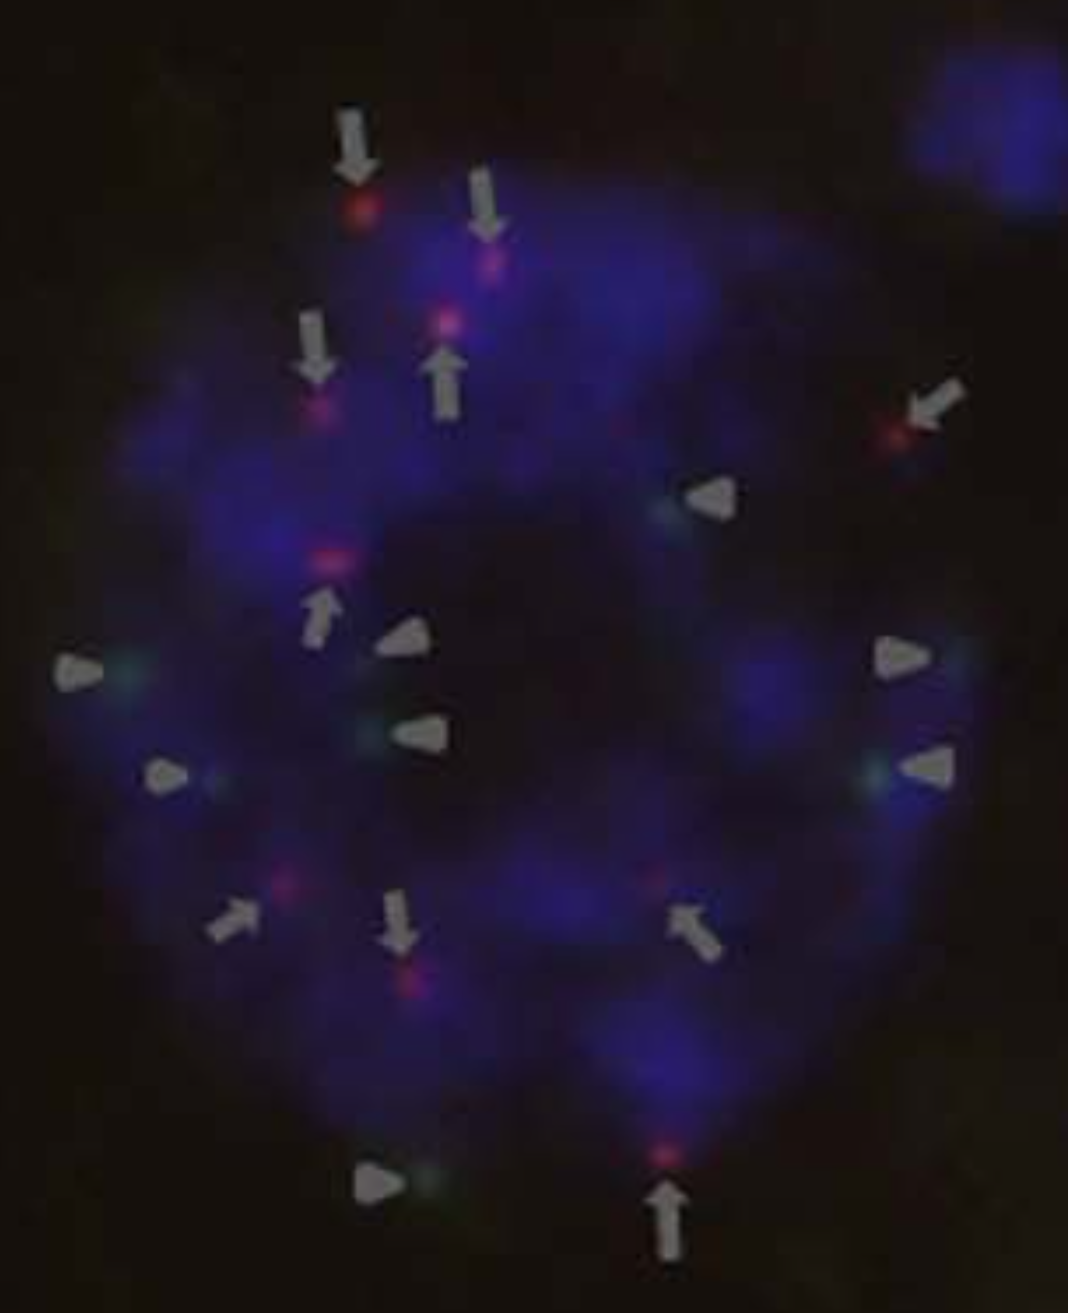
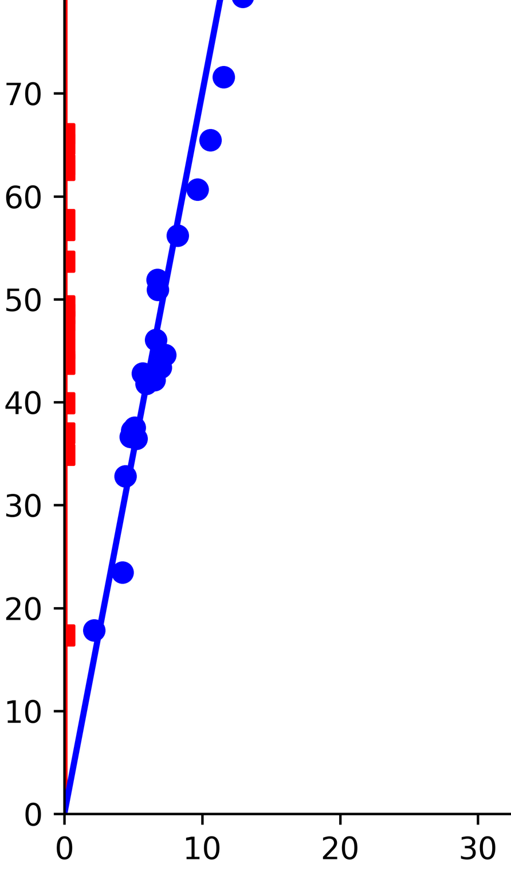
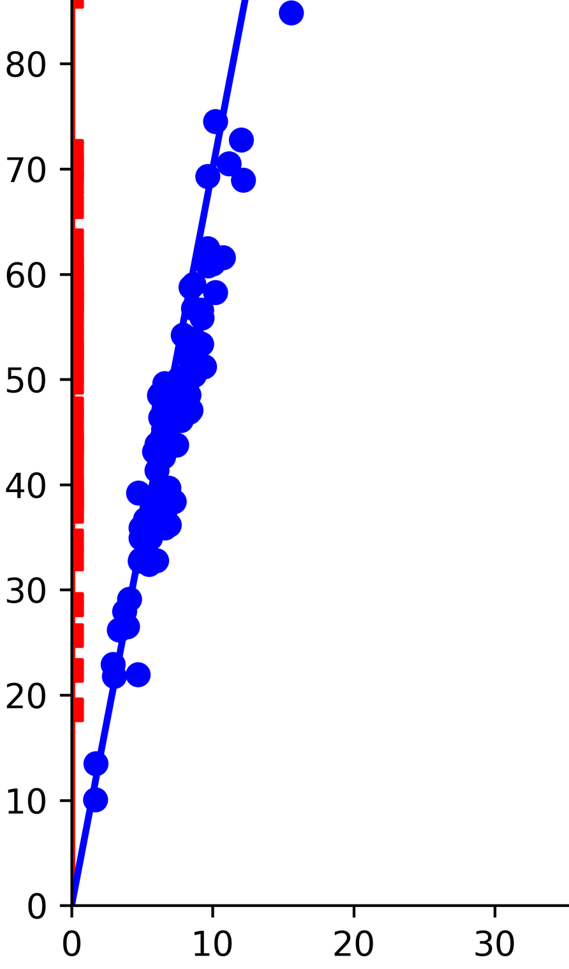
Ploidy level estimation in a sugarcane biparental population
python ../supermassa/src/SuperMASSA.py --print_genotypes --inference f1 --ploidy_range 2:12 \
--file sugarcane_data/SugSNP_382.pro --f1_parent_data sugarcane_data/SugSNP_382.par \
--draw_genotypes --draw_genotype_histogram --save_figures "SugSNP_382" > SugSNP_382.html
Results
Pr(G = g*, parameter* | D) = 1.0
'ploidy': 8
'parameter': ((0, 8), (1, 7)) Predicted genotypes
1 (1, 7) 10 (0, 8) 101 (0, 8) 102 (1, 7) 103 (1, 7) 104 (0, 8) 105 (1, 7) 106 (1, 7) 107 (0, 8) 109 (0, 8) 11 (0, 8) ...
parents
offspring

Slide 9
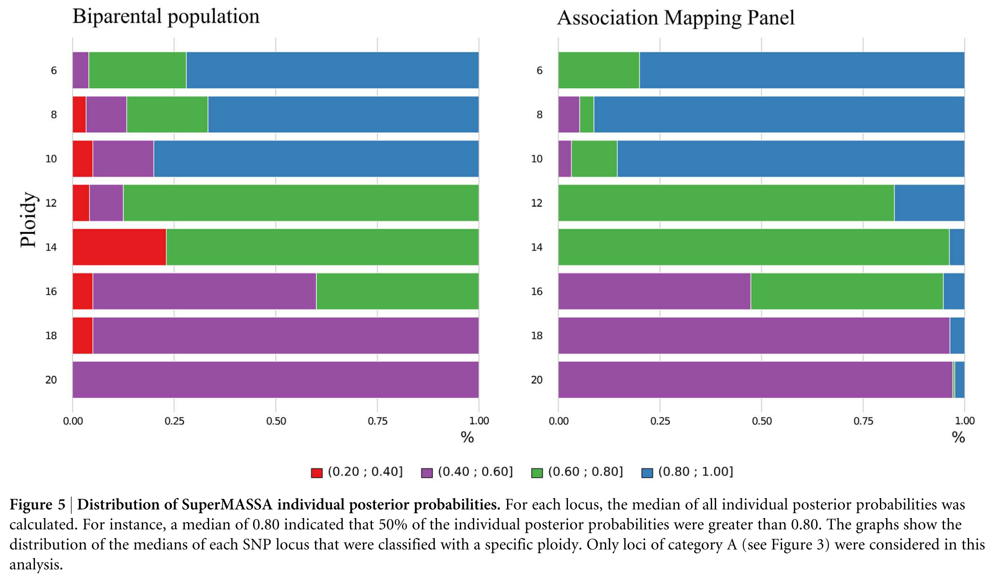
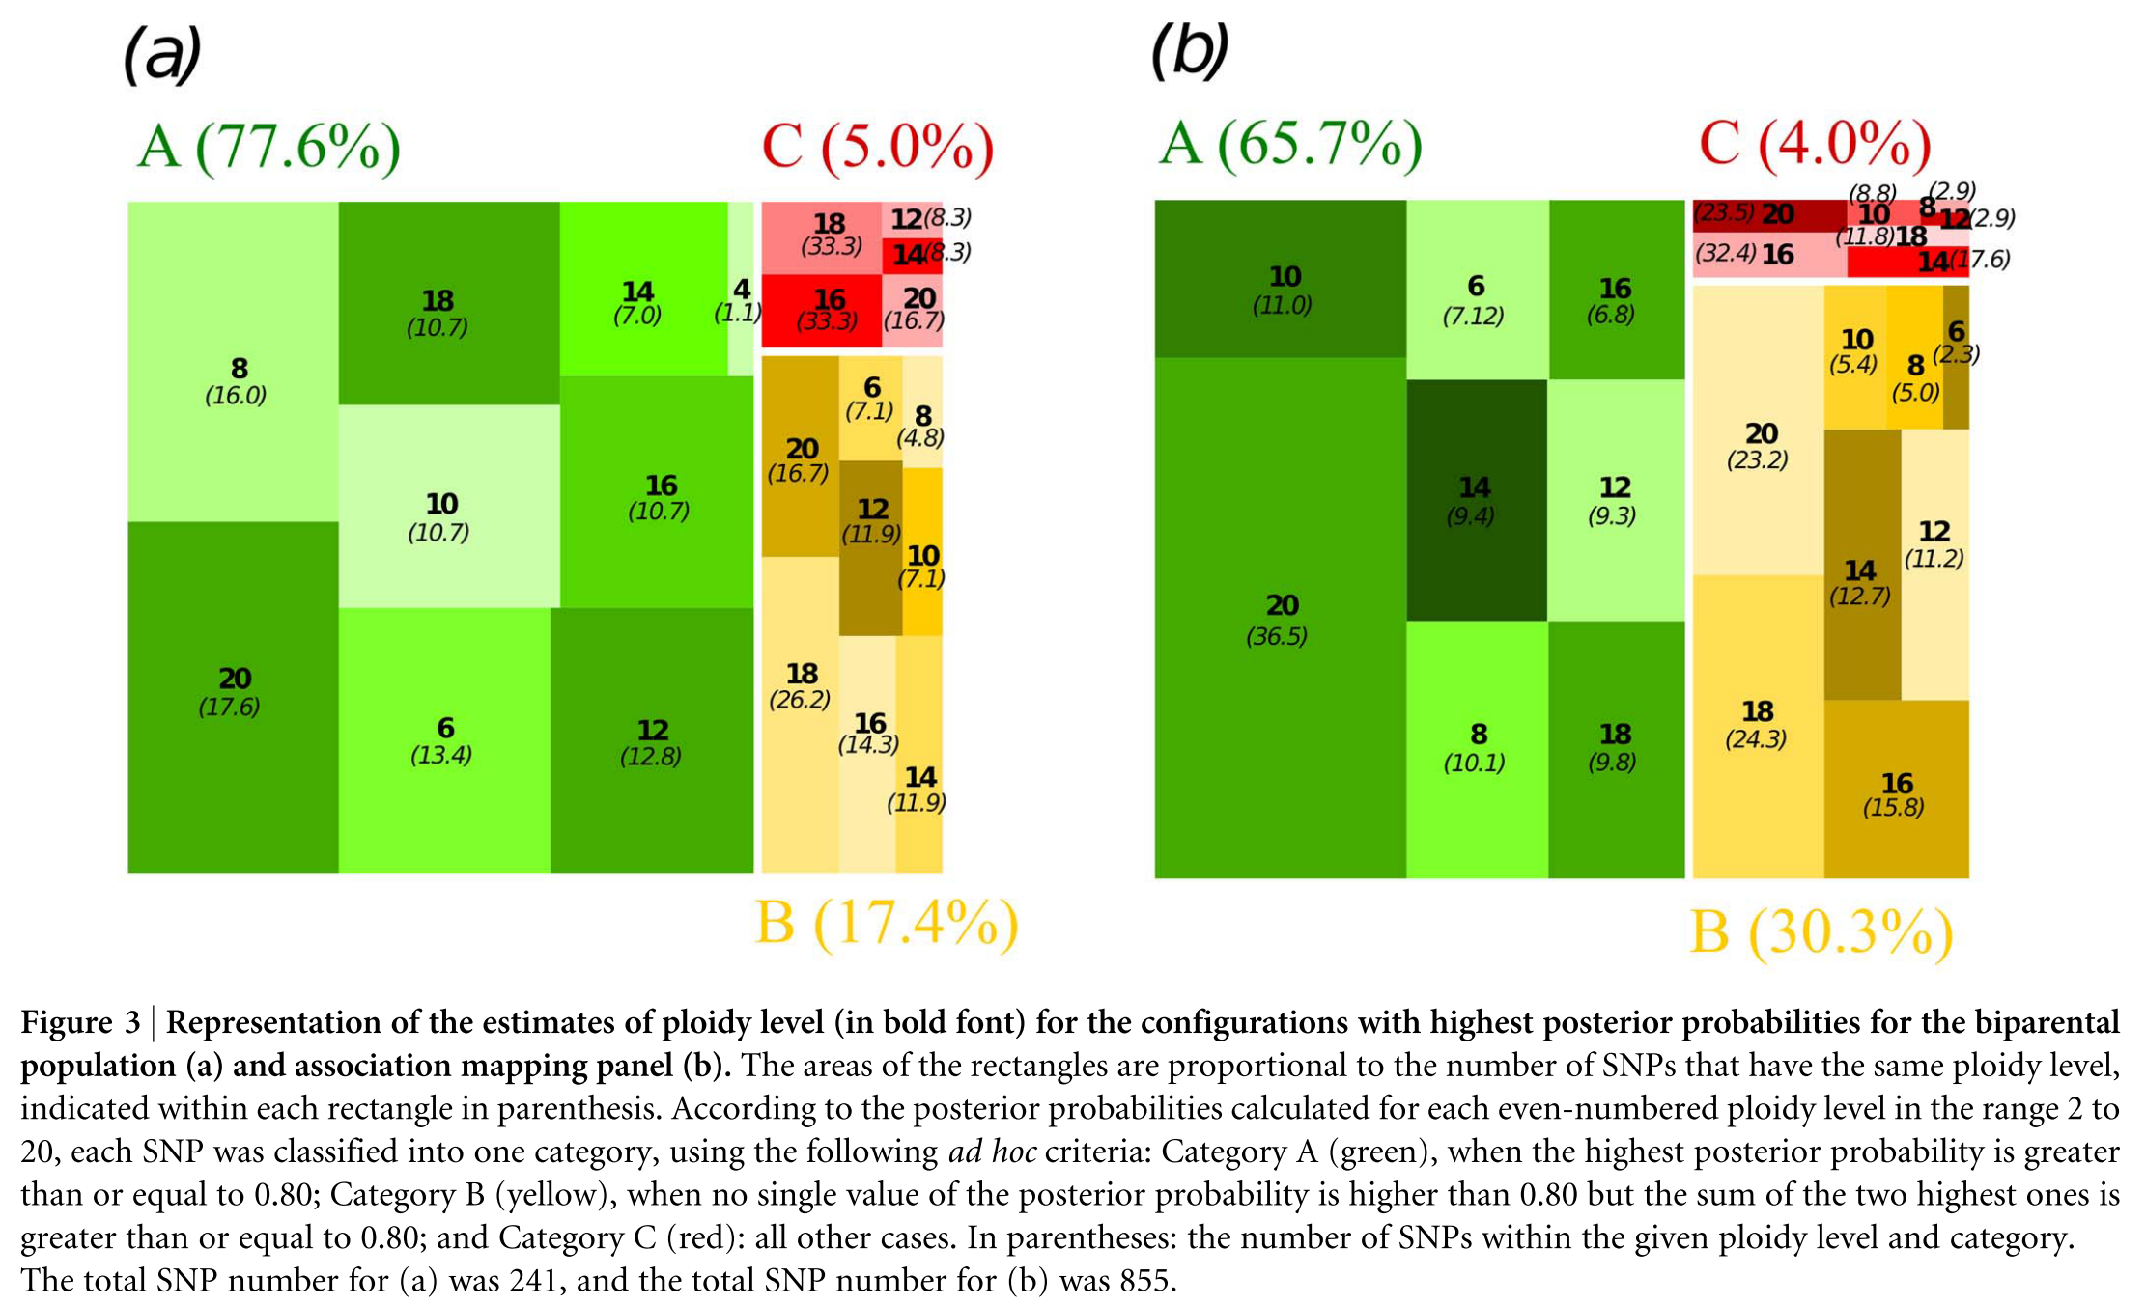
Ploidy level estimation in a sugarcane biparental population
﻿Representation of the estimates of ploidy level for the configurations with highest posterior probabilities
﻿Distribution of SuperMASSA individual posterior probabilities.

Slide 10
Genotype calling in a sweetpotato biparental population using VCF2SM
python VCF2SM.py -i ../data/sample_vcf/sample_ch+.vcf \
-o sample_trifida_sm_chr+.vcf \
--sF 1 \
--eF 3 \
-d 20 \
-D 2000 \
-a AD \
-g BT \
-1 Beauregard \
-2 Tanzania \
-S ~/repos/supermassa/src/SuperMASSA.py \
-I f1 \
-M 2:6 \
-f 6 \
-p 0.80 \
-n 0.75 \
-c 0.75 \
-t 24

Slide 11
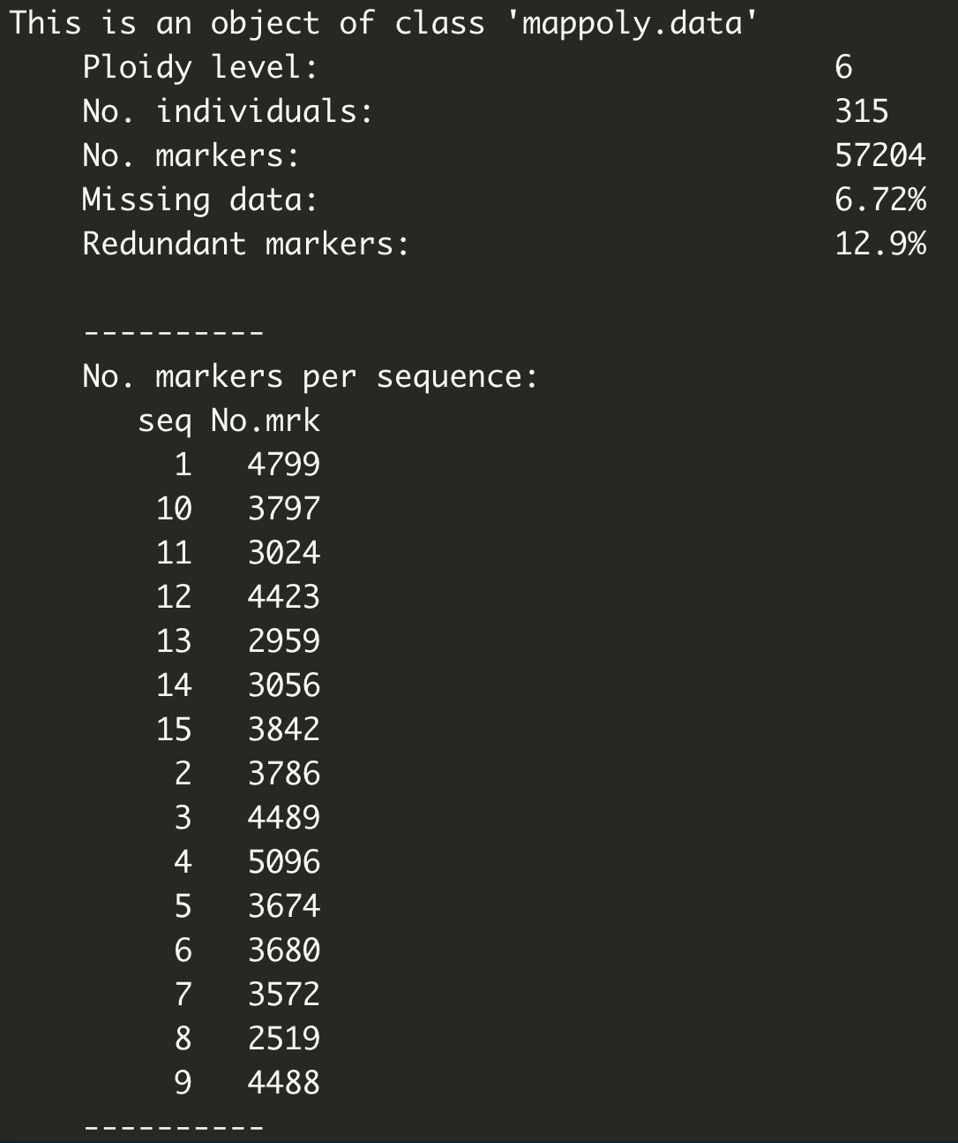
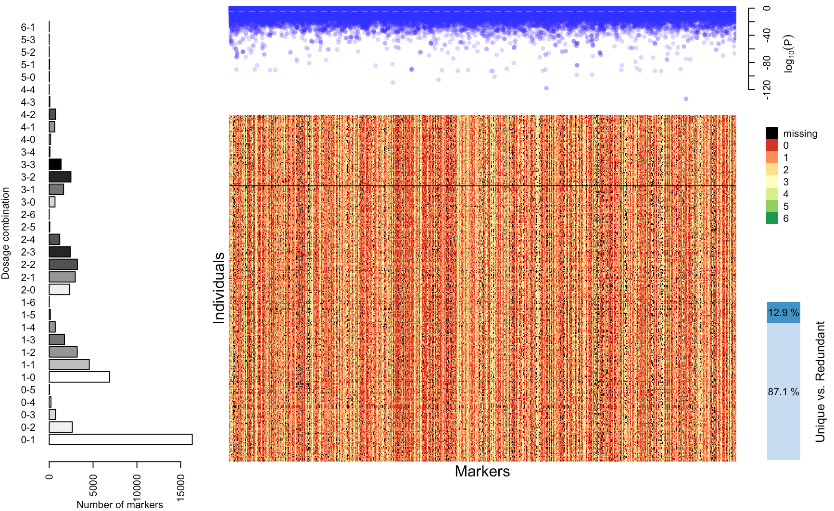
Genotype calling in a sweetpotato biparental population using VCF2SM

